Slide 1

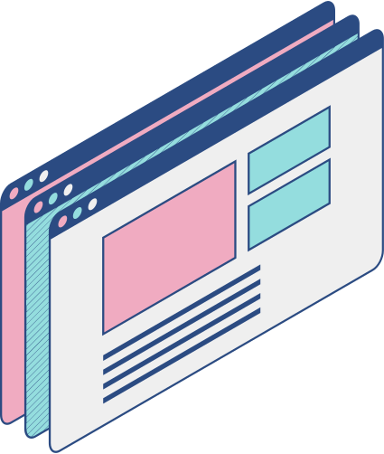


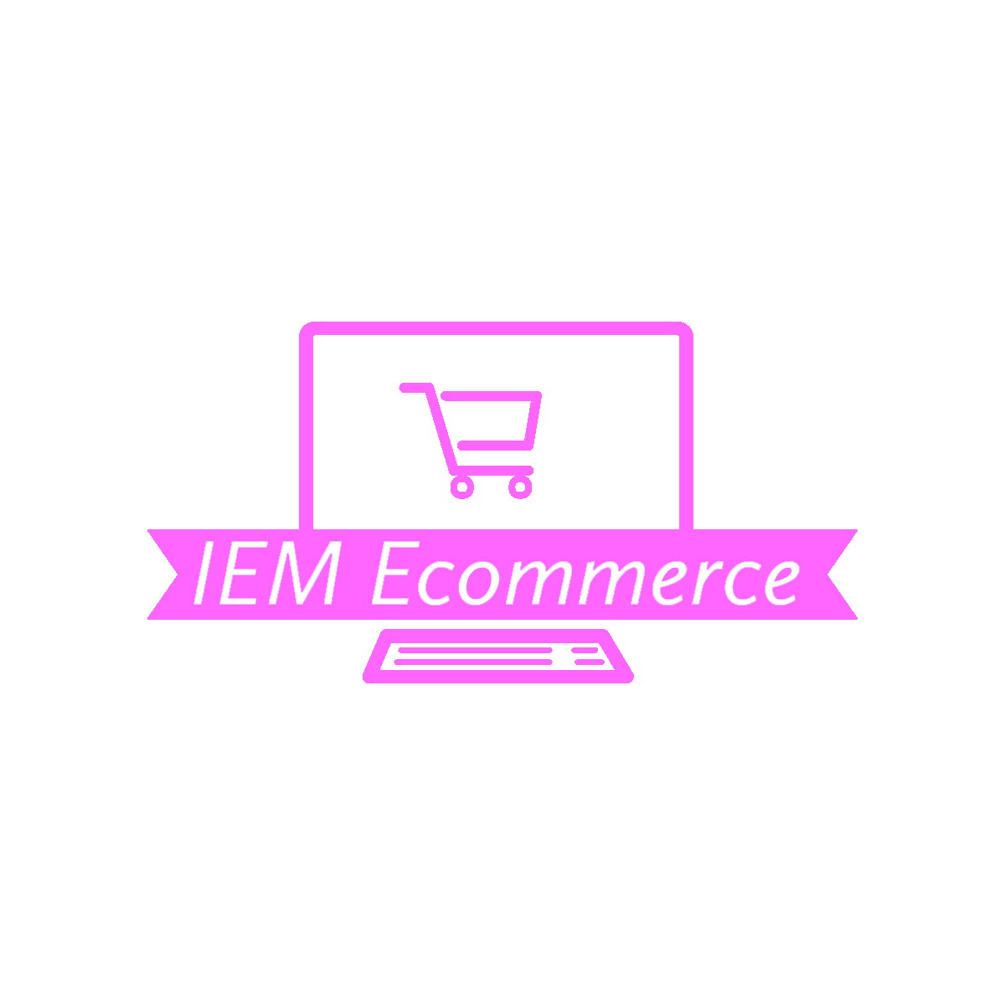

E-Commerce website
IEM ECOMMERCE
Presented by: Awab Anes Mohammed Saif.
ID: O21BCA16054.
Supervision of Mr. Abdul Mannan Abdul Razak. BCA - Bachelor of Computer Application to Chandigarh University.

Slide 2
index
-------------------------------------- File Project IEM Ecommerce in github
-------------------------------------- Acknowledgement
-------------------------------------- Certificate Guide
-------------------------------------- Supervisor Information
-------------------------------------- Nots
-------------------------------------- summary
-------------------------------------- Report
All attachments are located separately on the GitHub file that contains the project file “GitHub - AwabSaif/IEM-Ecommerce”

Slide 3
Acknowledgments
I would like to express my heartfelt gratitude to all those who have provided assistance and guidance throughout the course of my project, "IEM E-commerce."
First and foremost, I extend my sincere appreciation to my project guide, Abdul Mannan Abdul Razak, for their invaluable support, mentorship, and expertise. Their guidance has been instrumental in shaping the direction of this project and ensuring its successful completion.
I am also deeply grateful to the faculty members of Chandigarh University, whose encouragement and constructive feedback have been invaluable throughout this journey. Their expertise and insights have enriched my understanding and contributed significantly to the quality of this project.
Furthermore, I extend my thanks to my family and friends for their unwavering support and encouragement. Their belief in my abilities has been a constant source of motivation, spurring me on during challenging times.
Thank you all for your generosity, encouragement, and support throughout this endeavor.
Sincerely,
Awab Anes Mohammed Saif

Slide 4
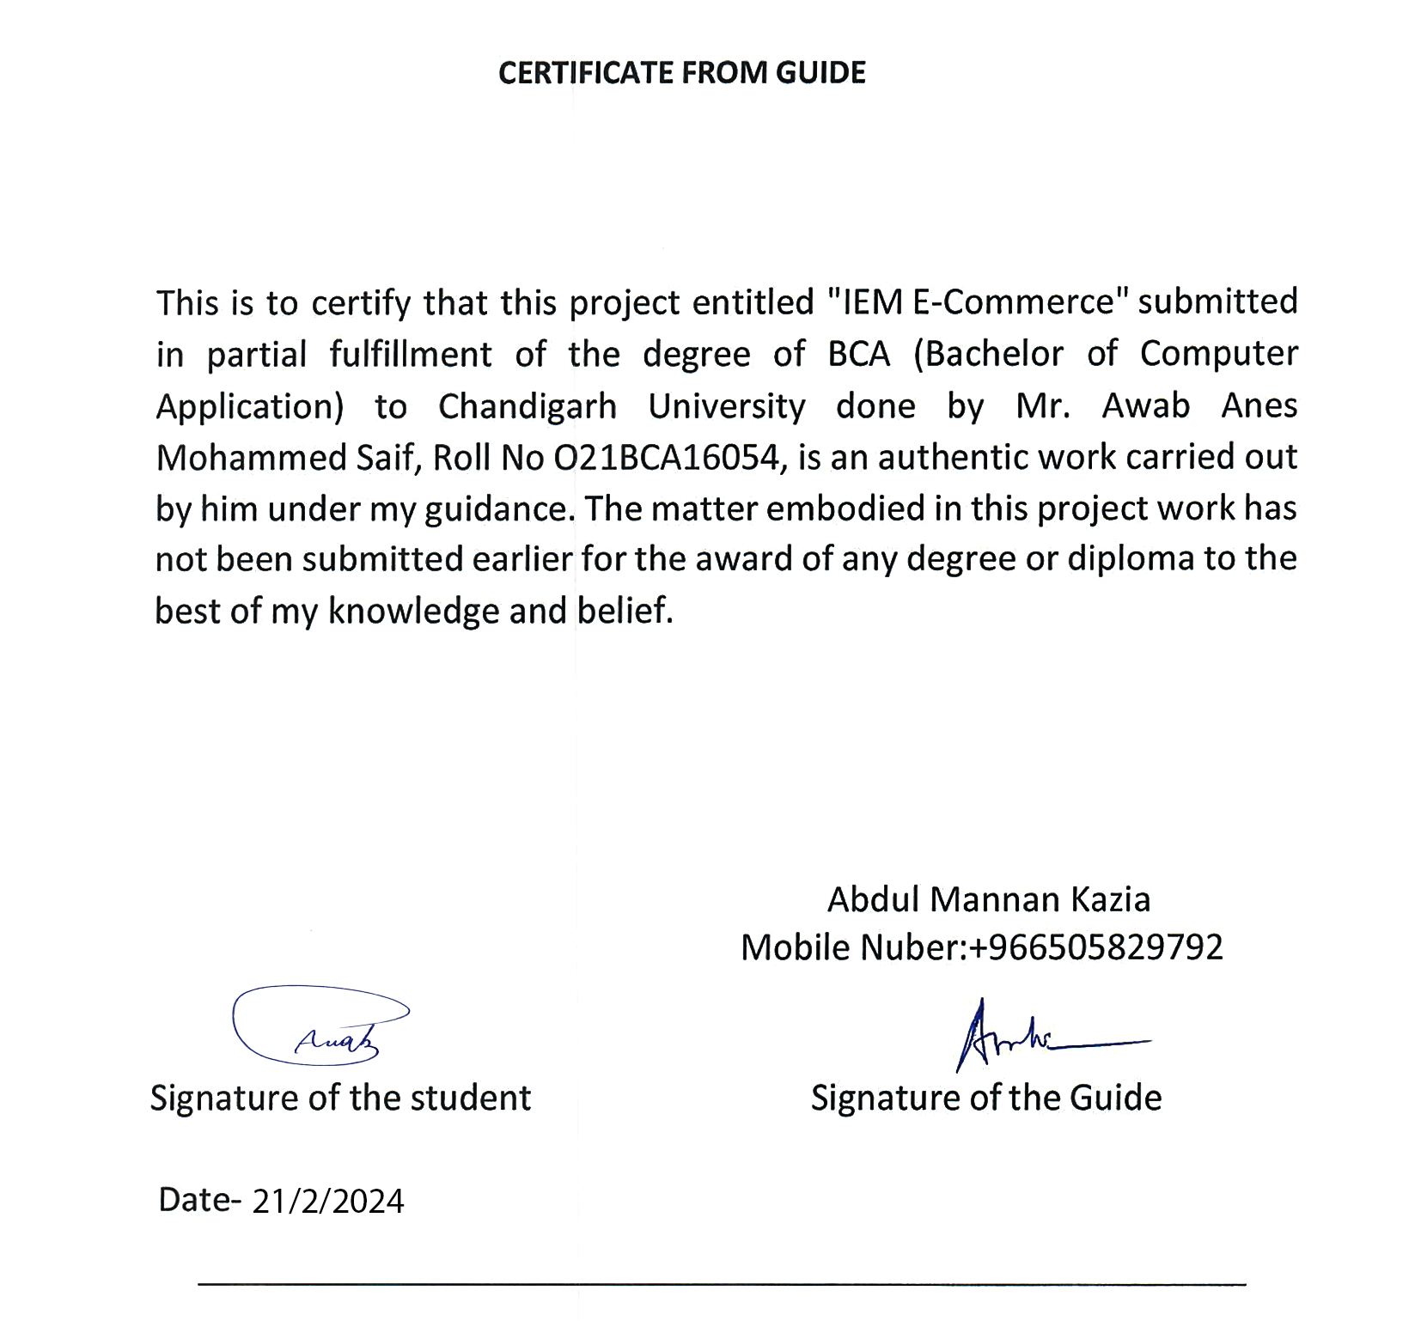

Slide 5
Supervisor Information:
Name: Abdul Mannan Abdul Razak
Contact Email: kaziamannan@gmail.com
Contact Number: +966 50 582 9792
Position: Software Developer

Slide 6
Nots
The project was not published on any server due to financial inability, It is available in GitHub, ready to be published.
How to run the project
To run the project, follow these steps:
Download the project files from GitHub
Backend:
Navigate to the Backend Directory:
Open your terminal or command prompt.
Change directory to the IEM Ecommerce backend folder.
Install Dependencies:
Run npm install to install all the required dependencies listed in the package.json file.
Start the Server:
You have two options to start the server:
Production Mode:
Run npm start.
Development Mode (with Nodemon):
Run npm run dev.
The server will start running, and you should see a message indicating that the server is listening on a specific port.

Slide 7
Nots
Frontend:
Navigate to the Frontend Directory:
Open another terminal or command prompt window.
Change directory to the IEM Ecommerce frontend folder.
Install Dependencies:
Run npm install to install all the required dependencies listed in the package.json file.
Start the Frontend Development Server:
Run npm run dev.
This command will start the development server using Vite, and it will automatically open a new tab in your default browser with the frontend application running.
Now, your backend server and frontend development server are up and running. You can access the frontend application by opening the provided URL in your browser.
Admin User
Email: Admin@gmail.com
Password: Admin@123

Slide 8
Summary
IEM E-commerce
Bridging the Gap Between Physical and Virtual Shopping Realms
Statement about the Problem:
The rise of the digital era has transformed the landscape of commerce, ushering in an era of unprecedented opportunities and challenges for businesses worldwide. However, amidst the rapid evolution of e-commerce, numerous shortcomings plague existing online platforms, hindering their effectiveness and limiting their potential for growth. The primary issues revolve around the outdated nature of many e-commerce websites, inefficient management systems, and the absence of accurate analytical reports, all of which contribute to a subpar user experience and hinder businesses' ability to thrive in the competitive digital marketplace.
Why is the particular topic chosen?
The topic of "IEM E-commerce" was chosen to address these pressing challenges and revolutionize the online shopping experience. By developing a cutting-edge online store that seamlessly integrates the physical and virtual realms, we aim to set a new standard for convenience, usability, and efficiency in e-commerce. This project presents an opportunity to leverage advanced technologies and modern design principles to bridge the gap between traditional brick-and-mortar stores and digital storefronts, empowering businesses and consumers alike.
Objective and Scope of the Project:
The primary objective of the "IEM E-commerce" project is to develop a comprehensive online shopping platform that enhances the digital shopping experience for users while providing administrators with powerful tools for efficient store management. The scope of the project encompasses:
Seamless User Experience:
Creating an intuitive and user-friendly interface for easy navigation and product discovery.
Implementing responsive design principles to ensure compatibility across various devices.
Enhancing the checkout process for a streamlined and hassle-free purchasing experience.
Powerful Administrator Dashboard:
Developing a comprehensive dashboard for administrators to manage products, inventory, orders, and customer data efficiently.
Generating detailed analytical reports to provide insights into customer behavior, sales trends, and website performance.
The project aims to significantly improve the online shopping experience for end-users, increase operational efficiency for administrators, and establish "IEM E-commerce" as a leader in the digital marketplace.

Slide 9
Methodology:
The development process of "IEM E-commerce" will follow a structured approach to ensure seamless functionality and user satisfaction. The methodology involves:
1.Requirements Gathering:
Engaging stakeholders to gather detailed requirements for the e-commerce platform, including features, functionalities, and user roles.
2.System Design:
Creating wireframes, mockups, and database schemas to visualize the user interface, user experience, and data storage structure.
3.Development:
Utilizing the MERN stack technology to implement the software system, including frontend and backend development, database design, and API integration.
4.Testing:
Conducting rigorous testing of all system components to identify and rectify any bugs or issues, ensuring functionality, reliability, and security.
5.Maintenance and Support:
Providing ongoing support, monitoring, and maintenance to address any issues, implement updates, and ensure the system's smooth operation.
Hardware & Software to be used:
Hardware Resources:
High-performance computing devices: Desktops or laptops with sufficient processing power and memory.
Devices for compatibility testing: Various smartphones and tablets.
High-speed internet connection.
Software Resources:
Integrated Development Environment (IDE): Visual Studio Code, Atom, or Sublime Text.
Version Control System (VCS): Git.
MERN stack components: MongoDB, Express.js, React.js, and Node.js.
Additional libraries and frameworks: Tailwind CSS, Axios, React Router DOM.

Slide 10
Testing Technologies used:
Unit testing, integration testing, and system testing.
Automated testing tools and manual testing techniques.
Contribution of the Project:
"IEM E-commerce" contributes to the e-commerce landscape by addressing the shortcomings of existing online platforms and introducing innovative features and functionalities. The project aims to:
1. Enhance the online shopping experience for end-users through intuitive design and streamlined processes.
2. Increase operational efficiency for administrators with comprehensive management tools and analytical insights.
3. Establish "IEM E-commerce" as a leader in the digital marketplace, setting a new standard for convenience, usability, and efficiency in e-commerce.
Process Description:
The development process of "IEM E-commerce" involves a series of steps, including requirements gathering, system design, development, testing, deployment, and maintenance. The process is supported by flowcharts and DFDs to visualize information flow and system components.
Resources and Limitations:
Resources Required:
Hardware: High-performance computing devices, devices for compatibility testing, high-speed internet connection.
Software: IDE, VCS, MERN stack components, additional libraries and frameworks.
Industry Data: Market research data, product information.
Limitations:
Scalability challenges.
Security risks.
Technical constraints.
Resource constraints.
Regulatory compliance.

Slide 11
Conclusion:
In conclusion, "IEM E-commerce" represents a significant advancement in the e-commerce landscape, offering unparalleled convenience, accessibility, and efficiency for both customers and administrators. The project's innovative approach, key achievements, and distinctive features position it as a leader in the digital marketplace, poised to make a lasting impact on the future of online shopping. Through seamless user experience, advanced technology implementation, and powerful management tools, "IEM E-commerce" sets a new standard for excellence in e-commerce, empowering businesses to thrive in the competitive digital landscape.

Slide 12
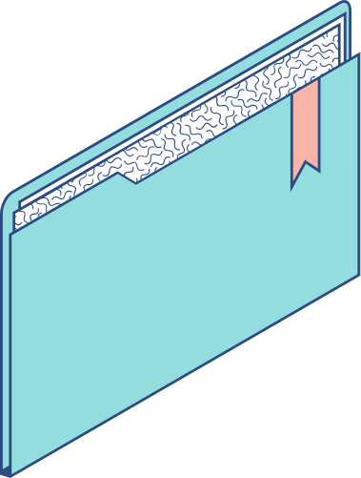
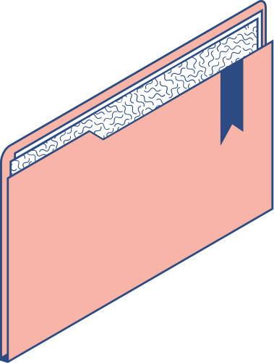
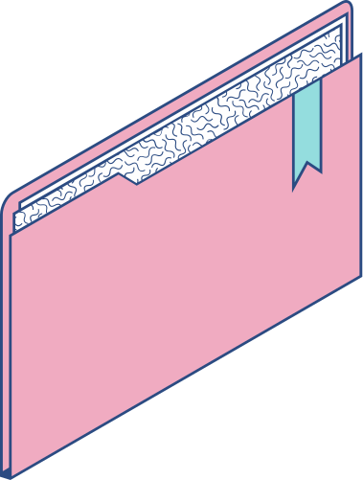
OUTLINE
INTRODUCTION
PROBLEM DEFINITION
PROPOSED IDEA OF THE PROJECT
REQUIREMENT
PROJECT FEASIBILITY
WEB APPLICATION TECHNOLOGIES USED
TEST TOOLS
DESIGN
SCREEN SHOTS OF SITE
FUTURE SCOPE
CONCLUSION
1

Slide 13

Introduction
Shopping is a fundamental part of daily life, involving the acquisition of goods and services from various retail outlets.
Two distinct realms shape our shopping experiences: the physical and the virtual.
In the physical realm, interactions occur in tangible spaces through face-to-face encounters.
The virtual realm encompasses interactions on the internet, transcending physical boundaries and allowing connections across vast distances.
2

Slide 14
IEM E-commerce serves as a bridge between these realms, offering a platform for individuals to showcase and sell products online.
E-commerce facilitates seamless exchanges of goods, services, funds, and data over electronic networks, particularly the internet.
It revolutionizes commerce, providing convenience and accessibility.
Through e-commerce, individuals can transcend geographical limitations, tap into global markets, and build successful businesses from home.
The project aims to empower aspiring entrepreneurs by providing tools and resources for navigating the digital marketplace.
3

Slide 15
Physical Realm
Virtual Realm
Interactions occur in tangible spaces.
Face-to-face encounters.
In-person transactions.
Traditional brick-and-mortar stores.
Physical products and storefronts.
Direct sensory experiences (touch, sight, etc.).
Interactions take place online.
Connections transcend physical boundaries.
Engagement through digital platforms.
E-commerce websites and apps.
Virtual storefronts and digital catalogs.
Remote transactions.
Access to global markets.
Digital communication tools (email, chat, etc.).
4

Slide 16


Problem definition
Challenge | Description
Lack of a modern and visually appealing online store | The current online store is outdated and not visually appealing, which may deter customers from shopping there.
Difficulty managing traditional online stores | The current system is difficult to manage, making it hard to add products, control categories, track inventory, and fulfill orders.
Absence of accurate analytical reports | The current system does not provide accurate data on customer behavior, making it difficult for store owners to understand their customers and improve sales.
5

Slide 17


Proposed idea of the project
Our project is to create a cutting-edge online store called "IEM E-commerce" that aims to offer users a seamless and enjoyable shopping experience while providing administrators with powerful tools to efficiently manage the store's operations. Leveraging the advanced MERN stack technology ensures high website speed and performance.
Smooth User Experience
Advanced MERN Stack Technology
Powerful Administrator Dashboard and Accurate Analytical Reports
- Intuitive and user-friendly interface for easy navigation.
- Responsive design to ensure compatibility across devices.
- Advanced search and filter options for efficient product discovery.
- Streamlined checkout process for a hassle-free purchasing experience.
- Utilization of MongoDB, Express.js, React.js, and Node.js for robust and scalable development.
- Implementation of best practices to optimize website speed and performance.
- Comprehensive dashboard allowing administrators to manage products, inventory, orders, and customer data efficiently.
- Generation of detailed analytical reports providing insights into customer behavior, sales trends, and website performance.
6

Slide 18
Proposed idea of the project
Benefits
Expanded Reach: Reach customers globally, beyond geographical limitations.
Increased Sales: Tap into a larger customer base, leading to higher sales.
Convenience: Allow customers to shop anytime, anywhere, at their convenience.
Cost Savings: Reduce overhead costs associated with traditional brick-and-mortar stores.
Scalability: Easily scale your business operations as demand grows.
Targeted Marketing: Utilize data analytics to target specific customer segments.
Improved Customer Insights: Gain insights into customer preferences and behaviors.
Competitive Advantage: Stay ahead in the market by offering online shopping options.
7

Slide 19


Requirement
Hardware
Software
Device: Desktop, tablet, or smartphone.
The device must be able to run the web browser smoothly.
Internet Connection: A stable and fast Internet connection to load website content quickly and without delay.
Screen: A screen of a suitable size to browse the website comfortably.
High resolution allows content to be displayed clearly and in quality.
RAM: 2 GB or more 4GB or more recommended
Processor (CPU): 1.5 GHz processor speed or higher.
Web Browser: User must have a compatible web browser, such as Google Chrome, Firefox, Safari, or Microsoft Edge.
8

Slide 20
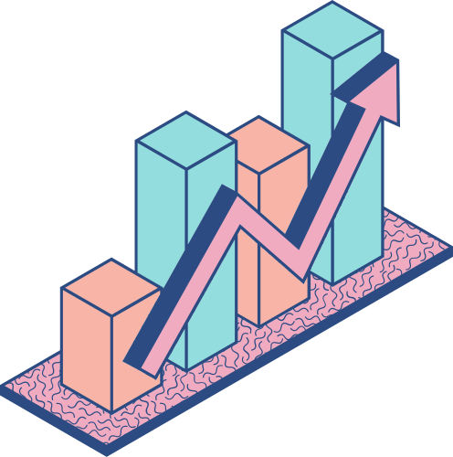
Project Feasibility
Technical Evaluation
Financial Evaluation
Operational Evaluation
-Utilization of Latest Technologies: The project appears technically feasible due to the utilization of the latest techniques and technologies.
- Ease of Implementation: Innovative and modern techniques facilitate the implementation of the project, making it meet the requirements of the modern market.
- Low Cost: The project has been designed with very low costs, making it financially sustainable.
- Free Service: The project will be available for free to all customers, increasing its attractiveness and potential revenue through advertisements or various revenue models.
- User-Friendly Interface: The project features an easy and simple user interface, making it suitable for everyone and easy to rely on.
- Reliability: The easy and straightforward application enhances the reliability of the project and attracts more users.
Considering the technical, financial, and operational feasibility aspects, the project seems robust and achievable. There is now an opportunity to achieve great success and make a positive impact on the target market
9

Slide 21






Web application technologies used
MERN Stack
The MERN stack is a JavaScript-based framework for building full-stack web applications. It consists of four main technologies:
MongoDB
Express.js
React.js
Node.js
MongoDB is a NoSQL database that uses a document-oriented data model. Unlike traditional relational databases like MySQL or PostgreSQL, MongoDB stores data in flexible, JSON-like documents. This allows for more dynamic and scalable data storage.
Express.js is a minimalist web application framework for Node.js. It provides a robust set of features for building web applications and APIs, including middleware for handling requests and responses, routing, and template engines.
React.js is a JavaScript library for building user interfaces. It allows developers to create reusable UI components and manage component state efficiently. React's virtual DOM and component-based architecture make it well-suited for building dynamic and interactive web applications.
Node.js is a JavaScript runtime environment that allows developers to run JavaScript code on the server-side. It provides an event-driven, non-blocking I/O model that makes it lightweight and efficient for building scalable network applications. Node.js is often used with Express.js to build the backend of MERN stack applications.
10

Slide 22



Frontend framework
1. React.js
Library for building UI with reusable components.
Component-based architecture for code reusability and scalability.
Virtual DOM for efficient UI updates and improved performance.
Built-in state management for dynamic and interactive interfaces.
2. Vite
Modern build tool for fast development workflows.
Development server with features like fast refresh.
Build optimizations for faster build times.
11

Slide 23

3. Tailwind CSS:
Utility-first CSS framework with pre-defined classes.
Built-in support for responsive design.
Extensive customization through configuration files.
4. Other Libraries and Dependencies:
axios: Library for making HTTP requests.
React Router DOM: Routing library for client-side navigation.
Additional UI libraries and components for enhanced functionality.
12

Slide 24

Backend framework with the database details
Node.js: JavaScript runtime for server-side development.
Express.js: Web application framework for Node.js, used for APIs and HTTP request handling.
MongoDB: NoSQL database for data storage.
Mongoose: MongoDB object modeling tool for data modeling and interaction.
Bcryptjs: Library for password hashing.
Jsonwebtoken: Library for JSON web token generation for authentication.
13

Slide 25
Dotenv: module for loading environment variables from a .Env file.
Cors: middleware for enabling cors in express.Js.
Multer: middleware for handling multipart/form-data for file uploads.
Nodemailer: module for sending emails in node.Js applications.
Morgan: http request logger middleware for node.Js.
Express-async-handler: utility function for handling exceptions asynchronously in express.Js route handlers.
14

Slide 26


Test tools
1. Postman:
Postman tool was utilized for testing Application Programming Interfaces (APIs) in the project. Postman was used to send requests to the API and automatically test their responses. Requests were configured, including necessary parameters such as headers and data, then sent, and responses analyzed to ensure correctness and compliance with expectations. Test requests were organized into different collections, and scripts were written to execute test operations automatically. With Postman, data could be recorded and monitored, and API performance comprehensively analyzed.
11

Slide 27
Test tools
2. Jest:
The Jest framework was employed for unit testing code units and components in the project. Test cases were written to verify the correctness and functionality of each part of the code, including components and functions. Jest was used to run tests automatically and analyze code coverage to ensure comprehensive code coverage. Errors were detected and effectively corrected by using Jest as a testing tool.
11

Slide 28
Test tools
3. Selenium:
The Selenium tool was used to test the project's user interface. Test scenarios were configured to simulate user behavior on the browser, such as filling out forms, clicking on links, and navigating between pages. Selenium was used to execute these scenarios automatically across different browsers, allowing comprehensive verification of user interface functionality and identification of any potential issues. Quality and stability of the user experience were ensured through the use of Selenium as an automated testing tool.
11

Slide 29
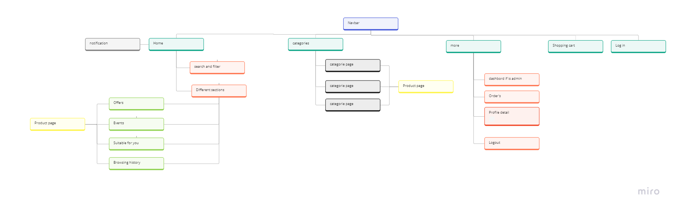
Design
First, we will start with the front-end display. We will start with data graphs and then screenshots
Header Structures
15

Slide 30
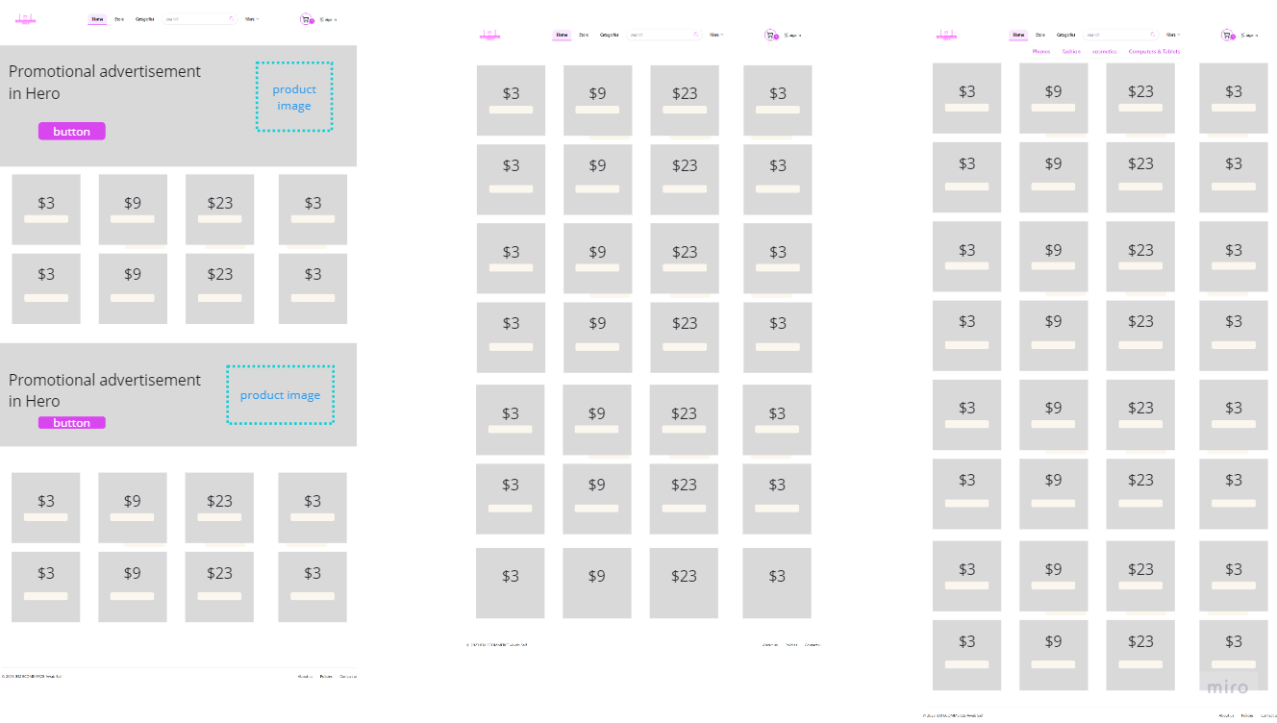
Store Design
16

Slide 31
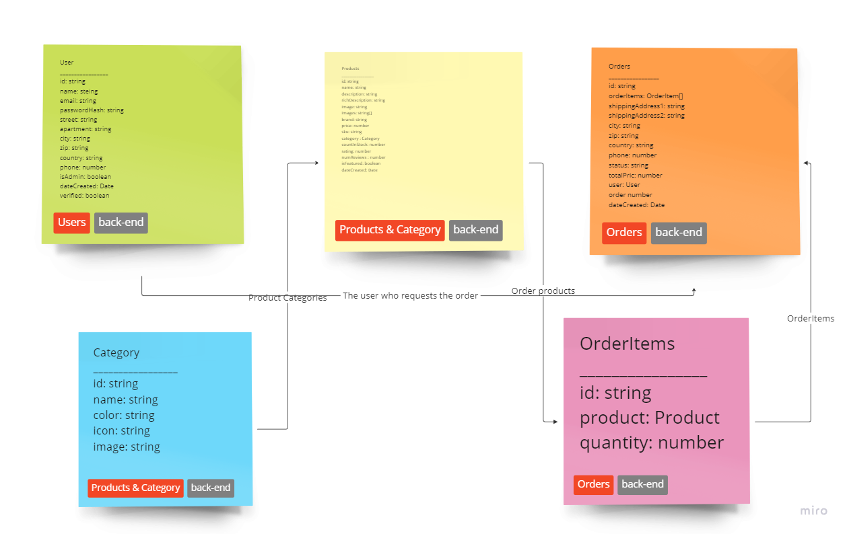
Database Design
17

Slide 32
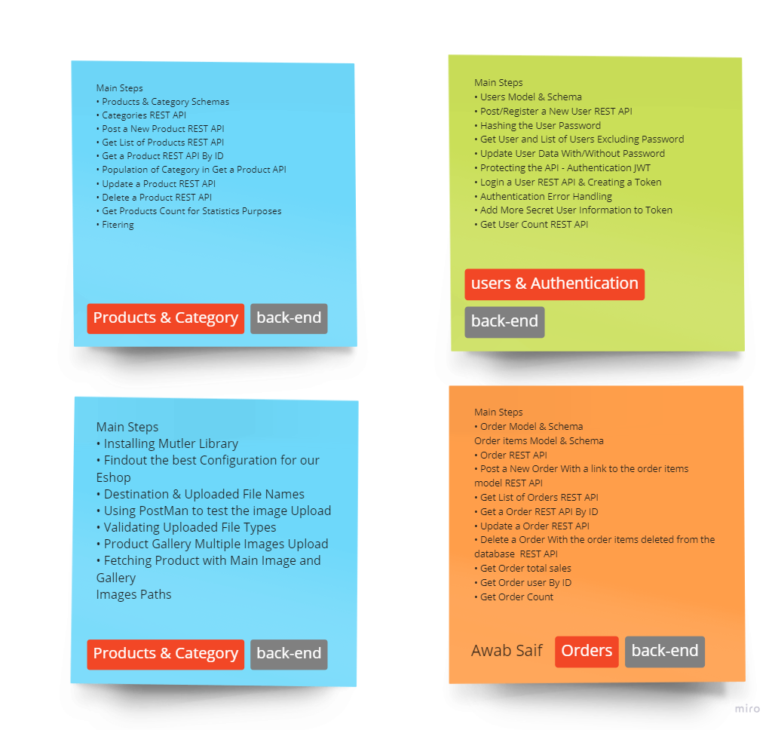
API Design
18

Slide 33
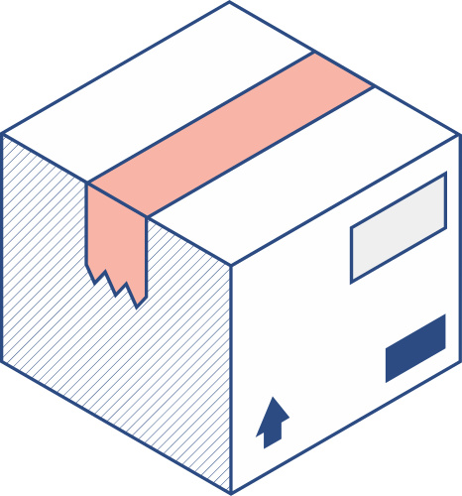
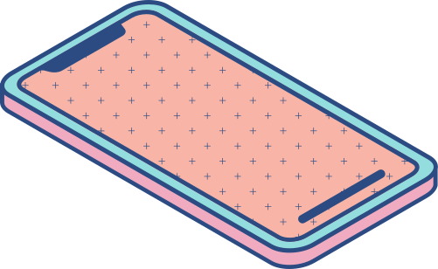
Screen Shots Of Site
19

Slide 34
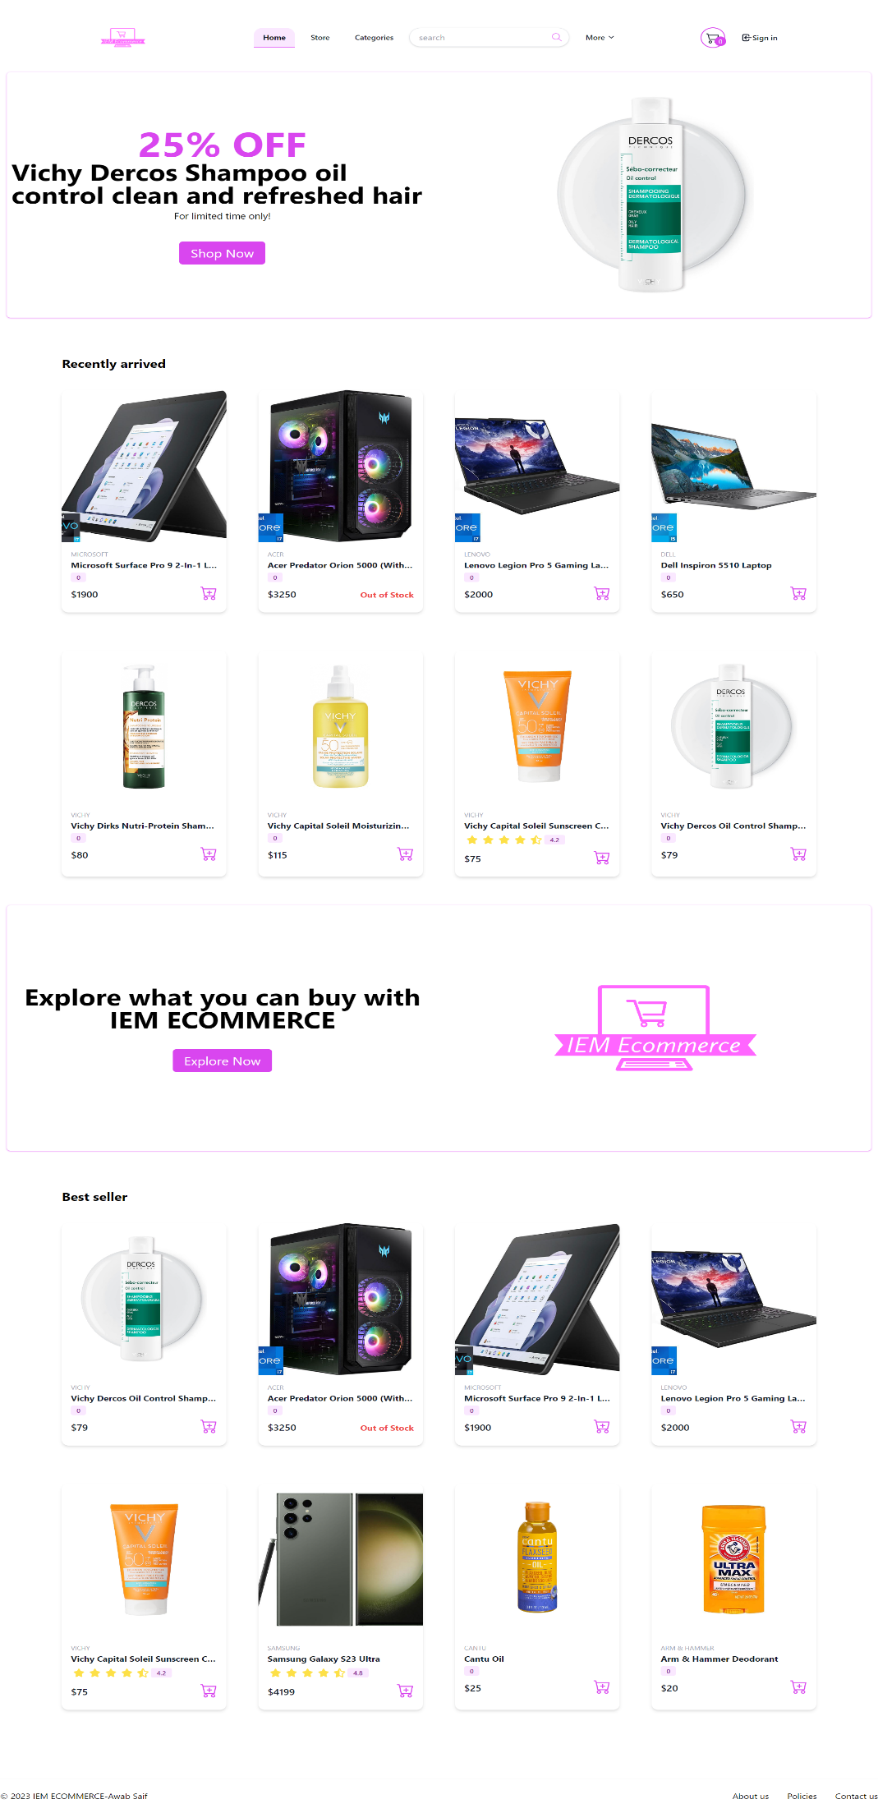
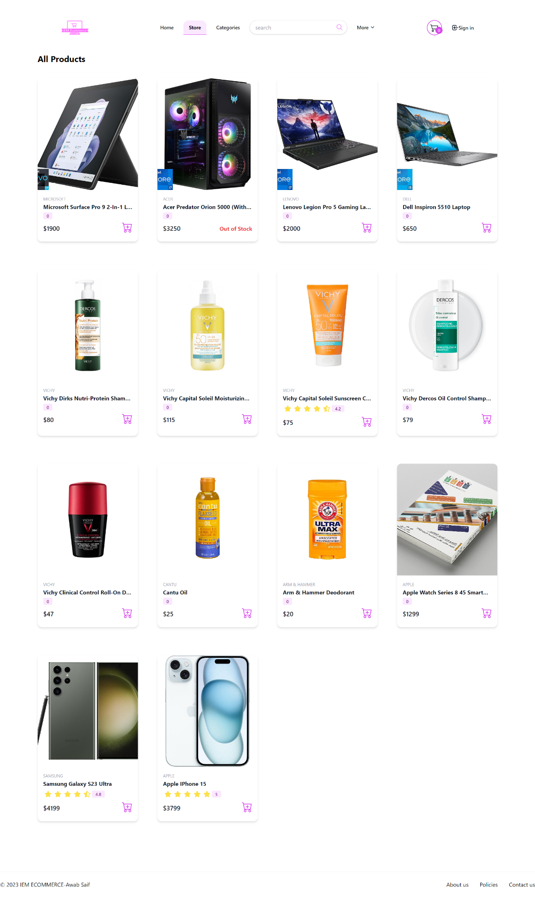
Home page
Store page
Displays all products in the store
20

Slide 35
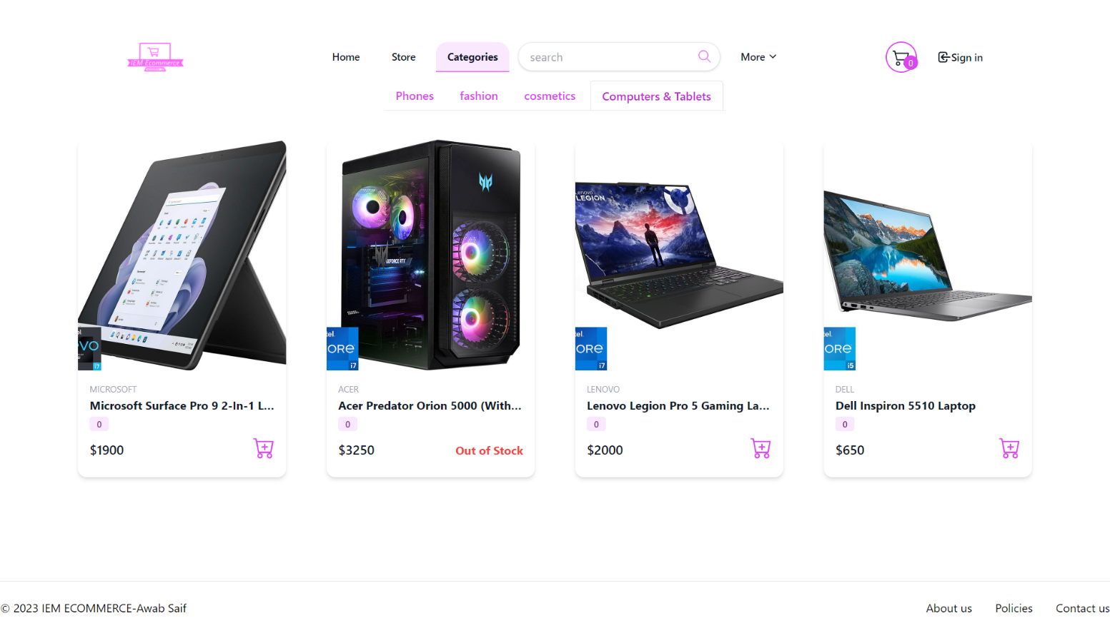
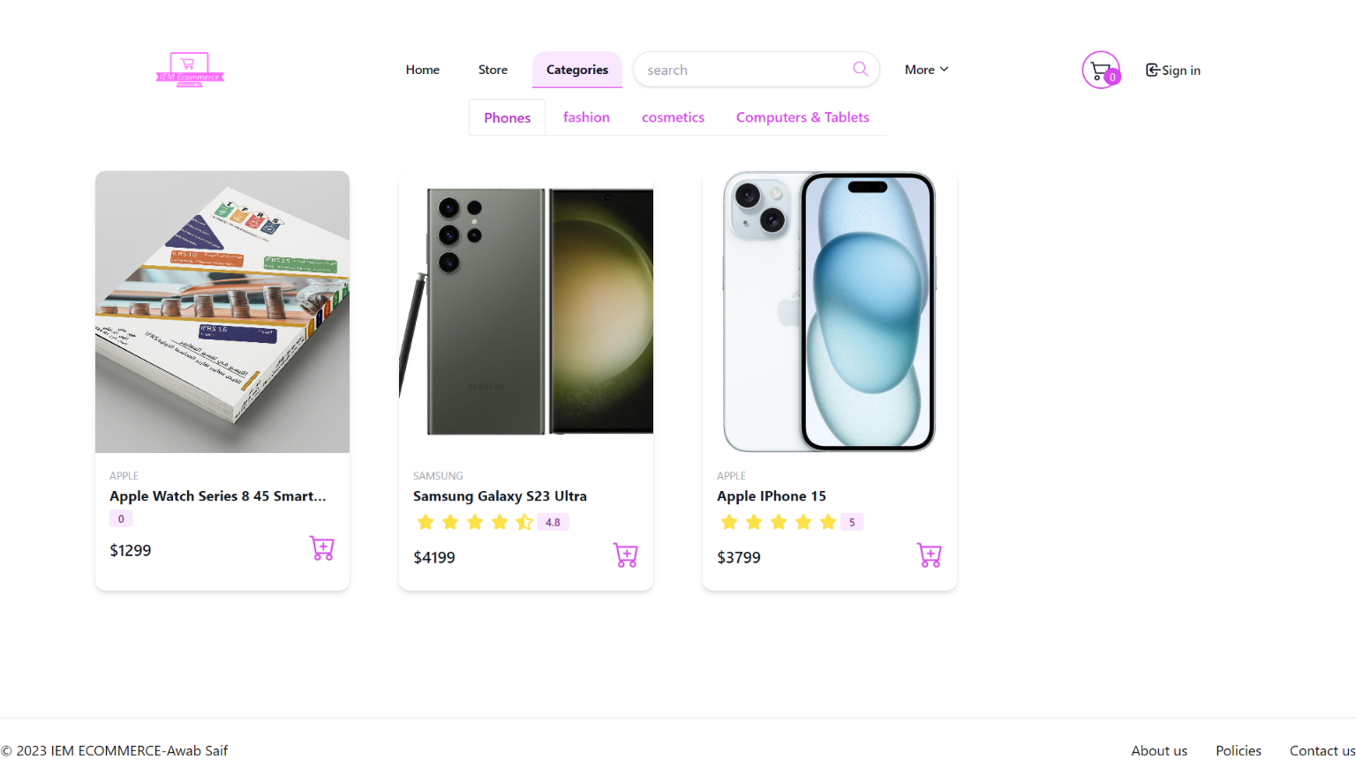
Categories page
filter by category
21

Slide 36
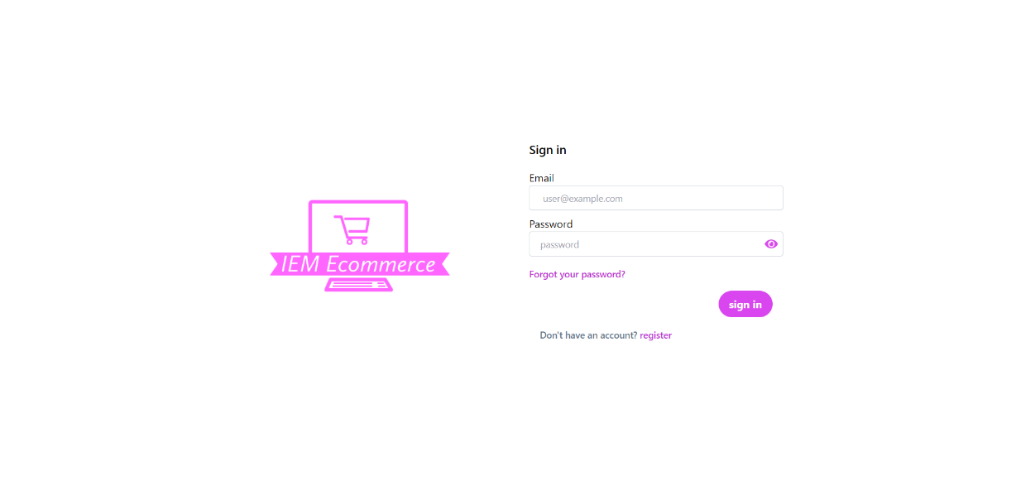
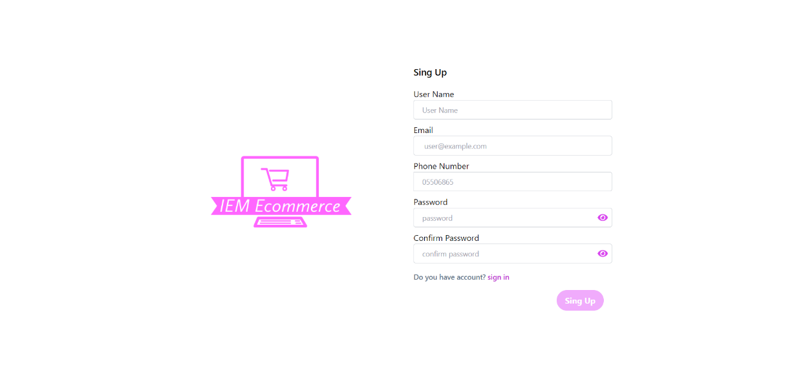
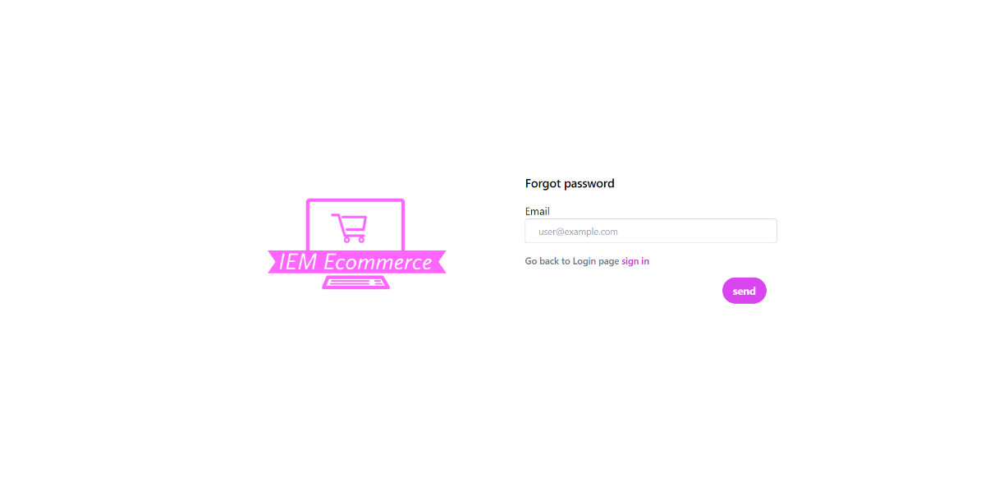
Login, register page
22

Slide 37
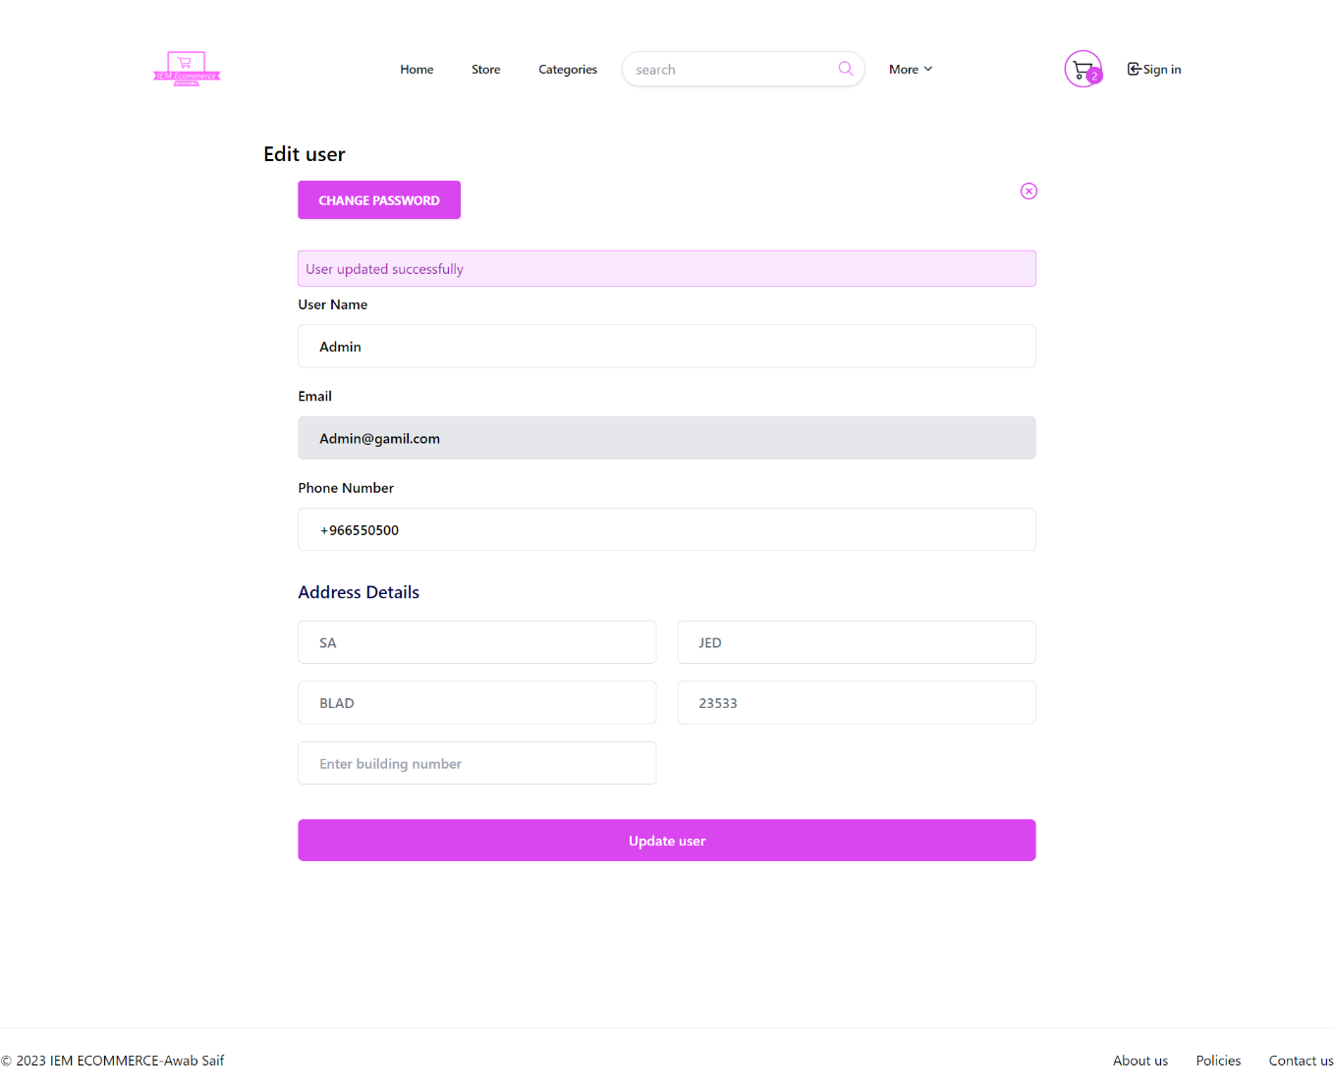
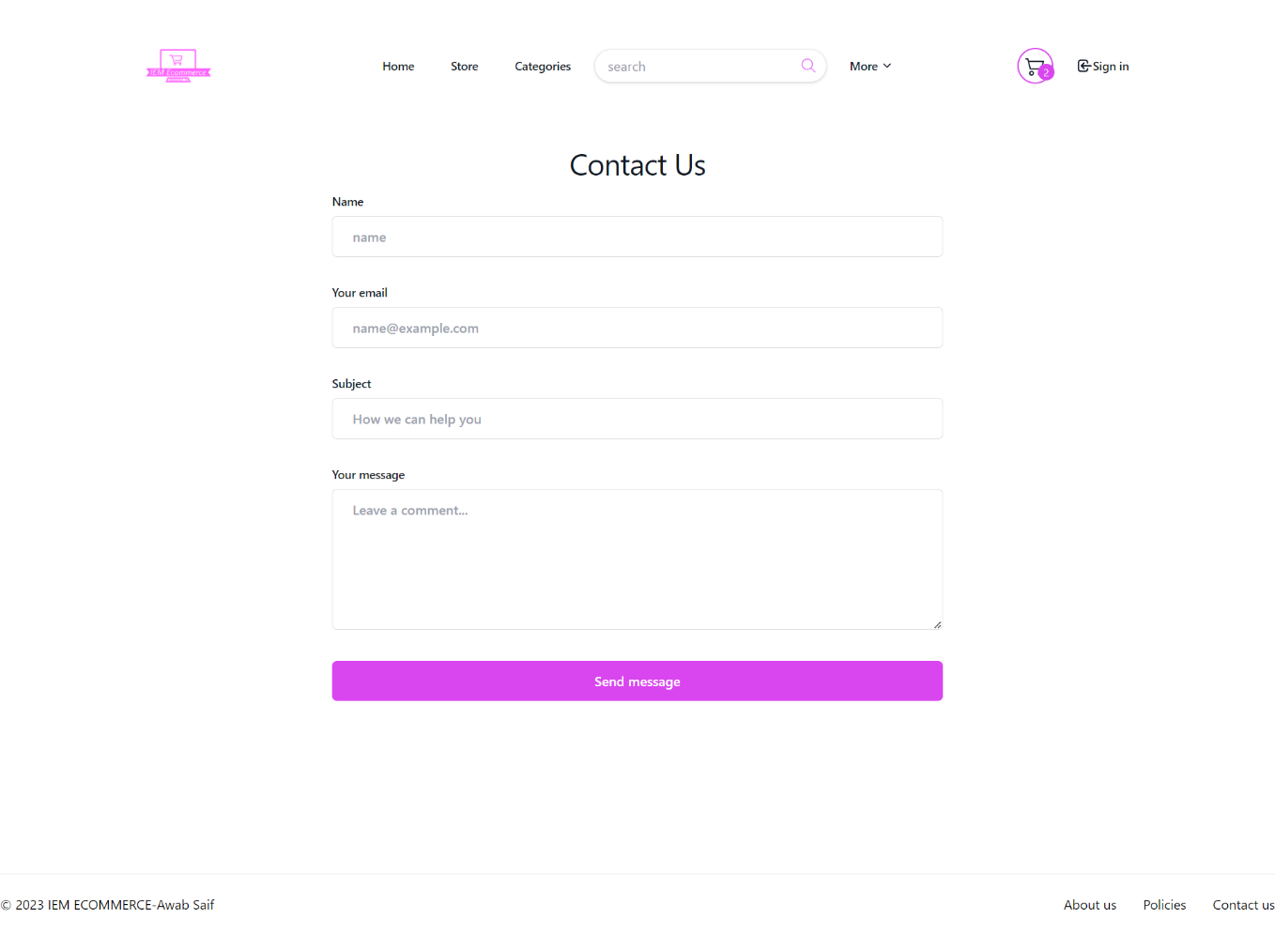
Profile page
Contact us page
23

Slide 38
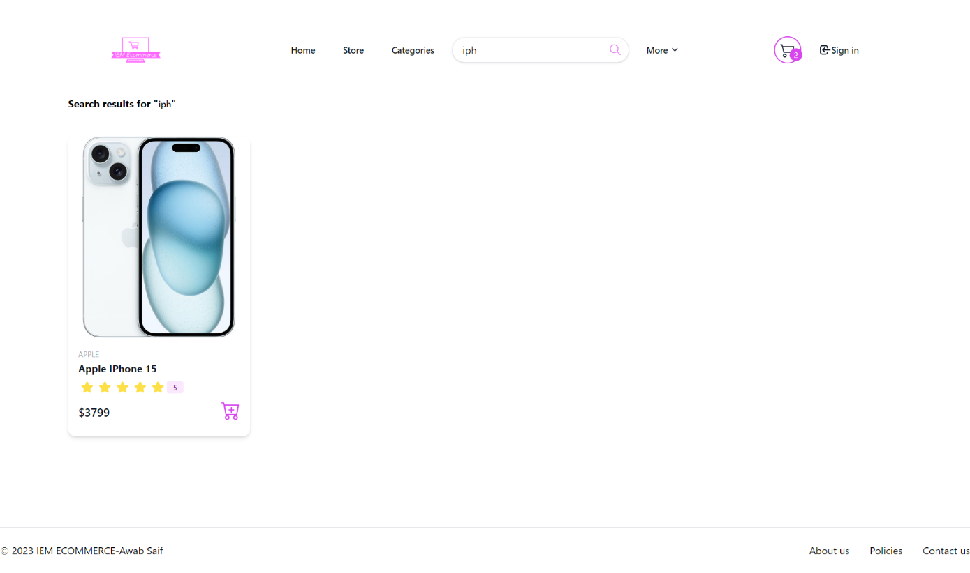
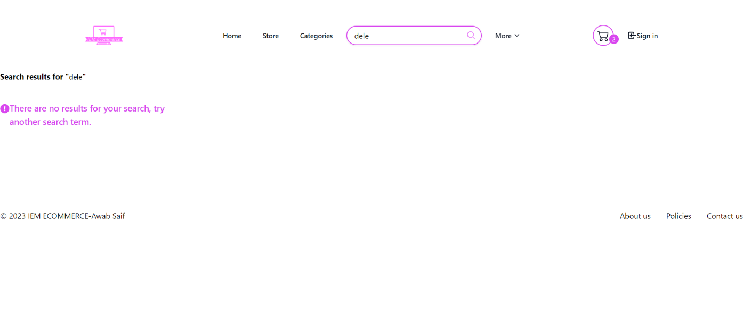
Search filter page
24

Slide 39
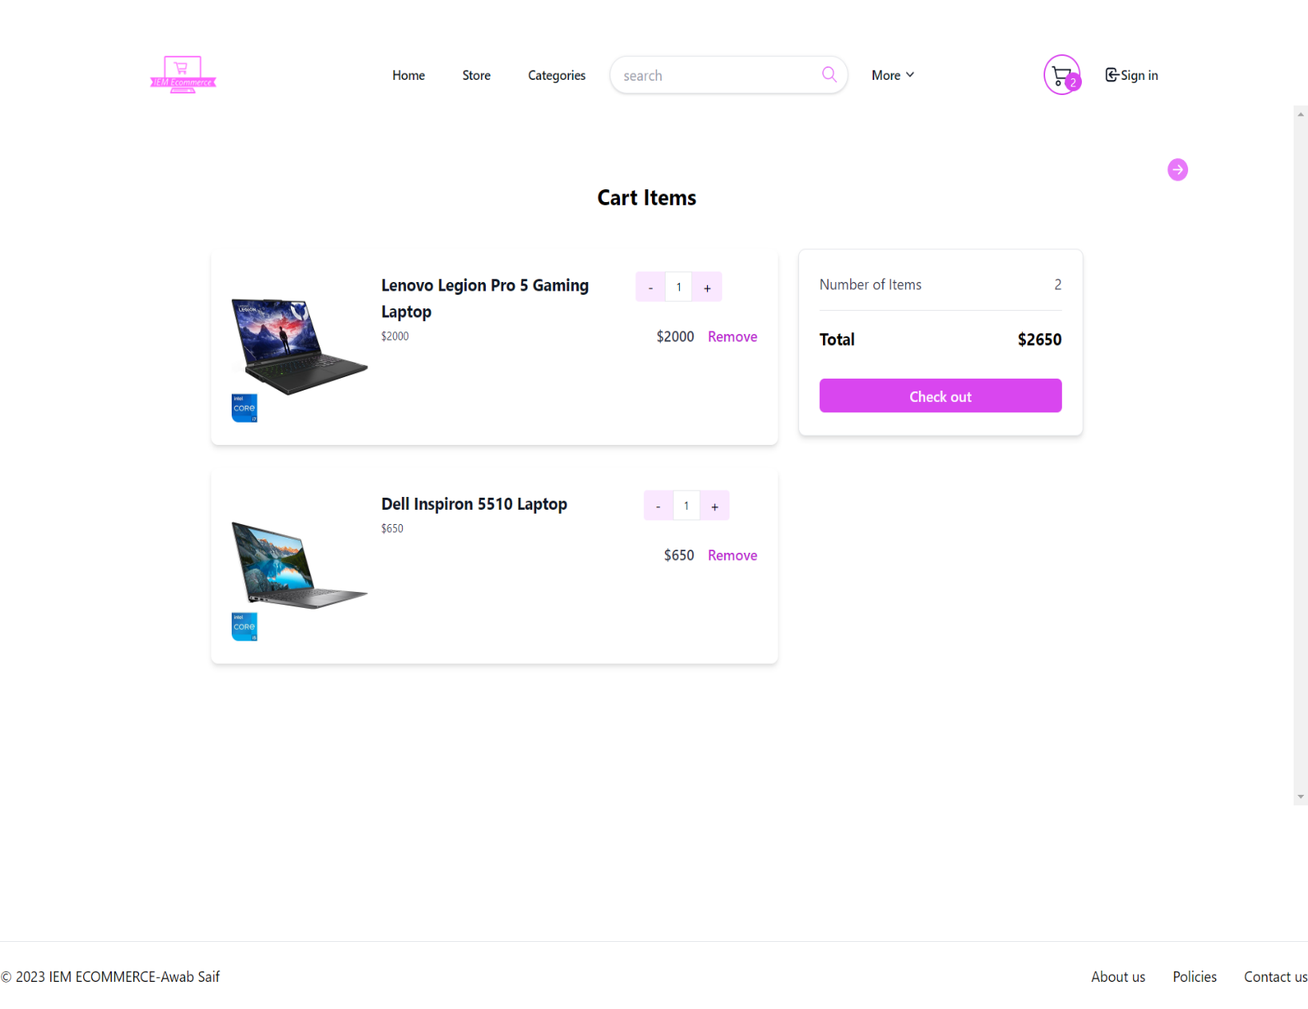
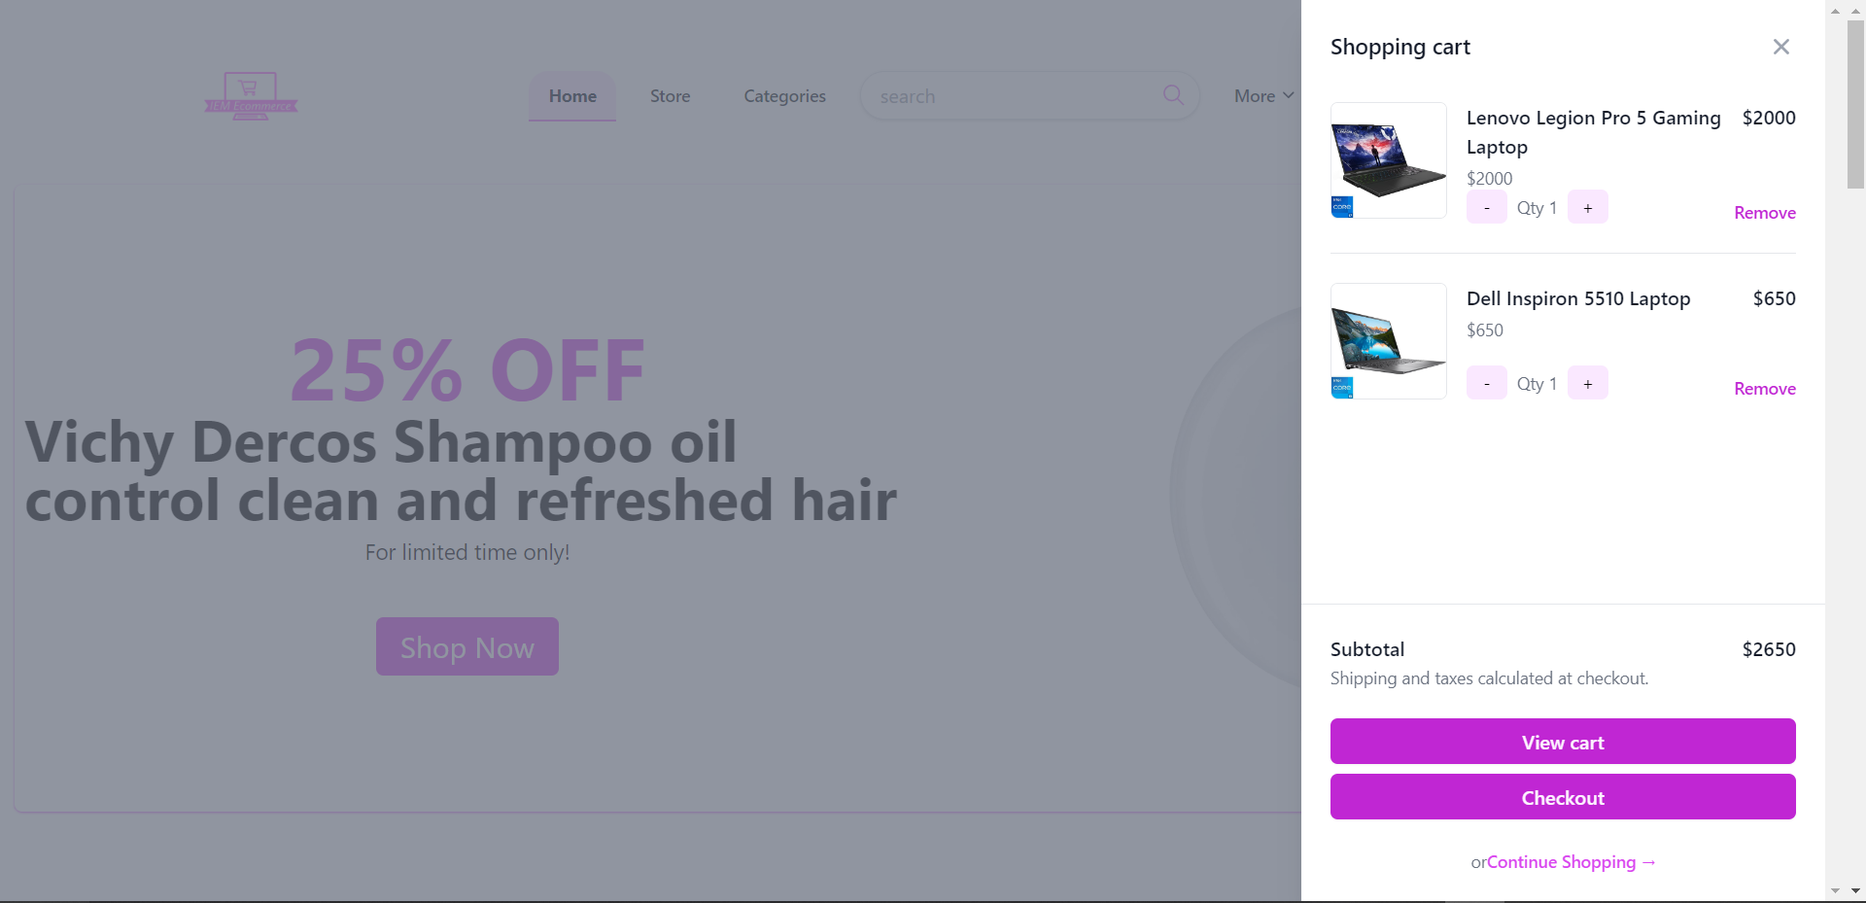
Cart page
25

Slide 40
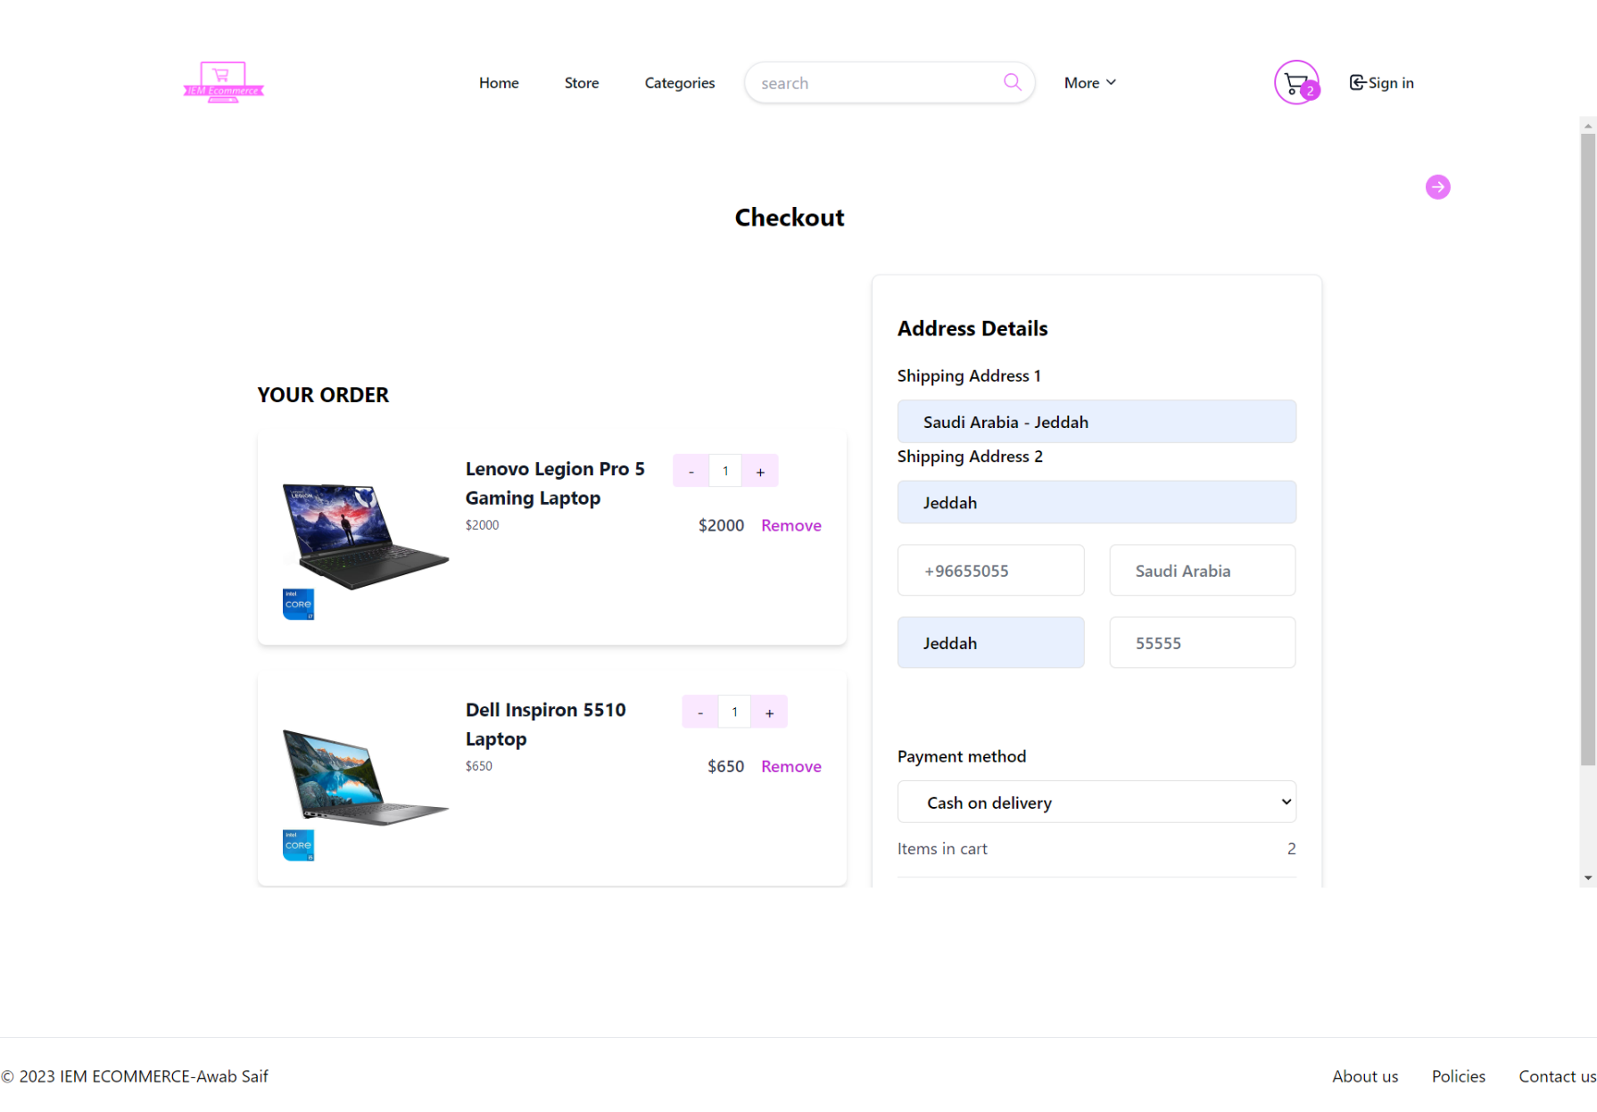
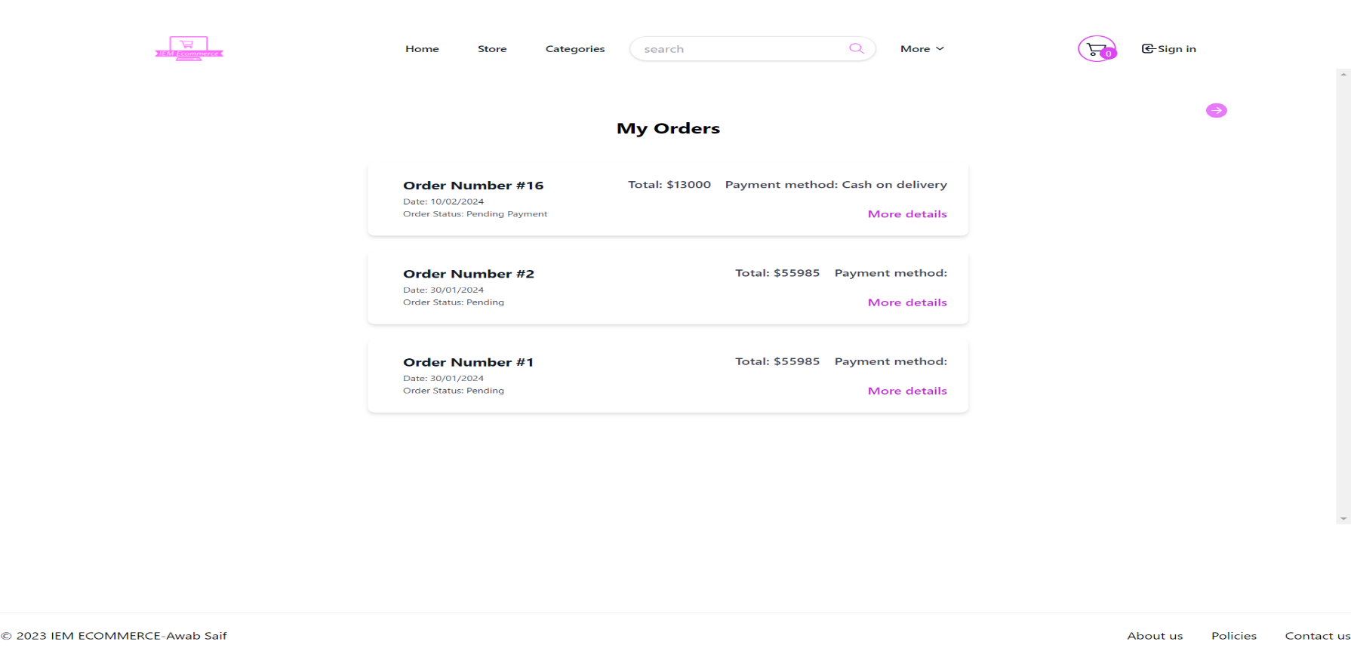
checkout page
Orders page
26

Slide 41
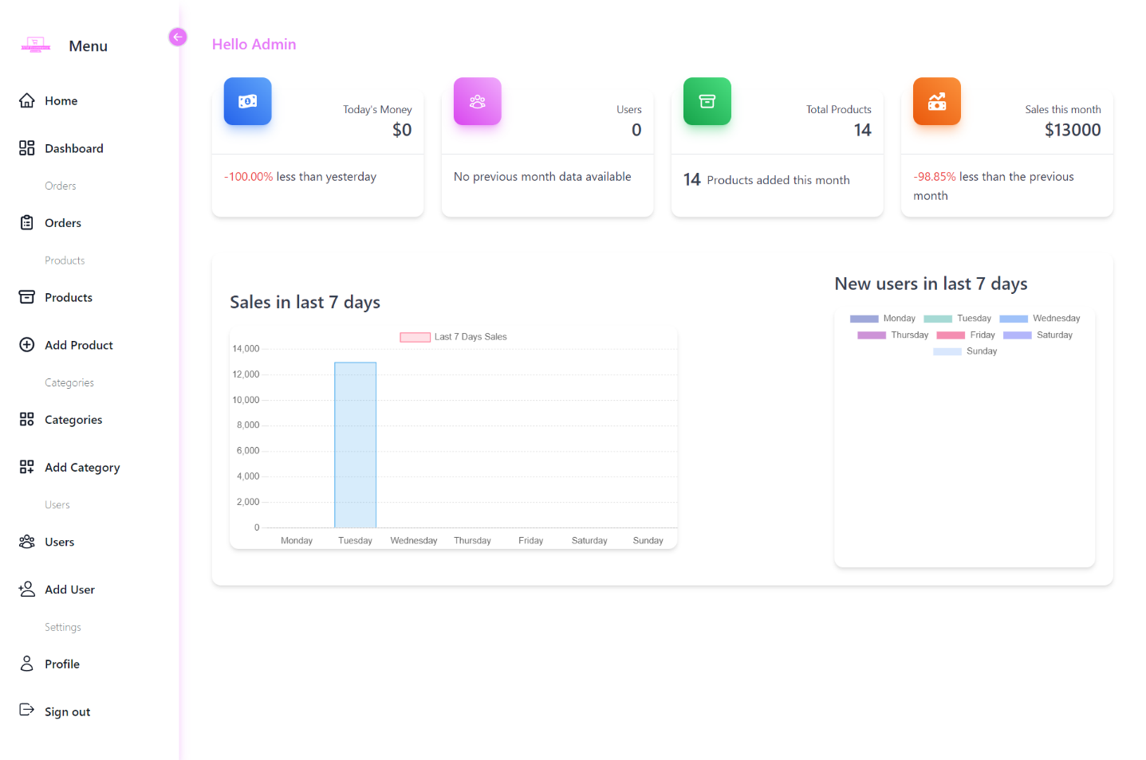
Dashboard pages
27

Slide 42
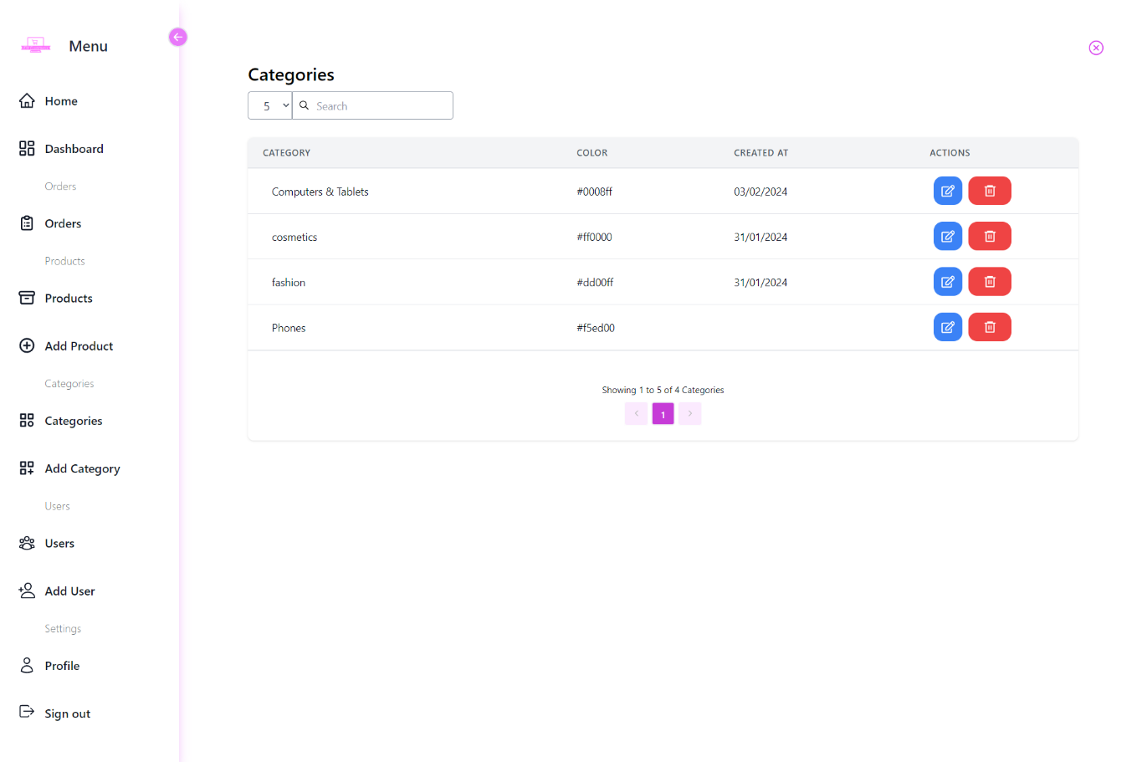
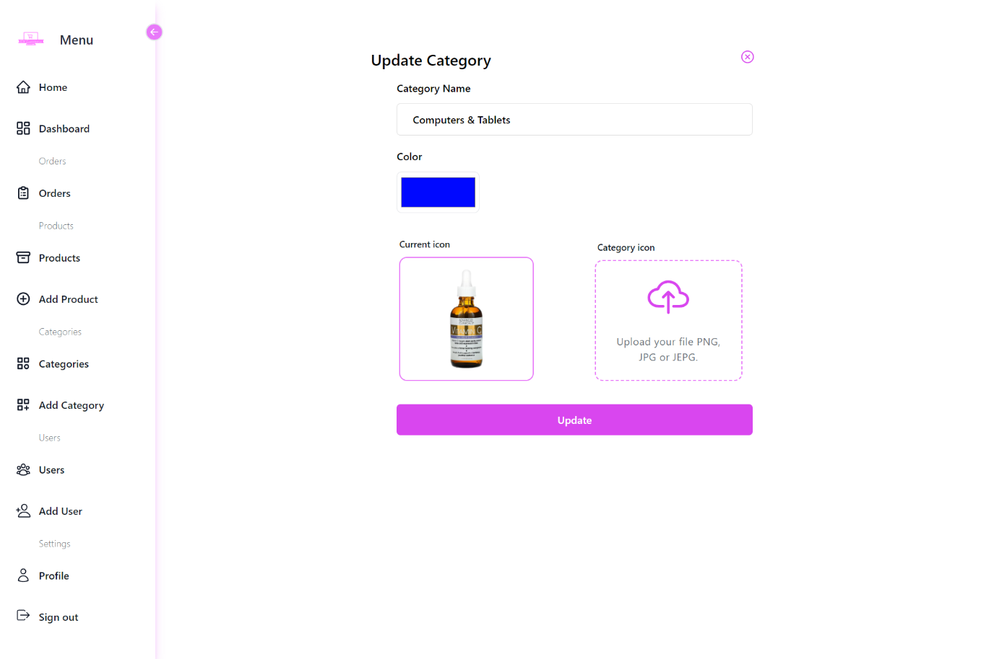
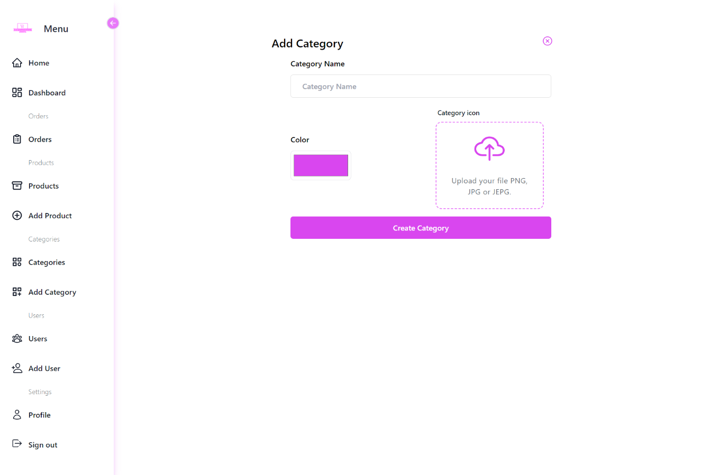
Categories pages
28

Slide 43
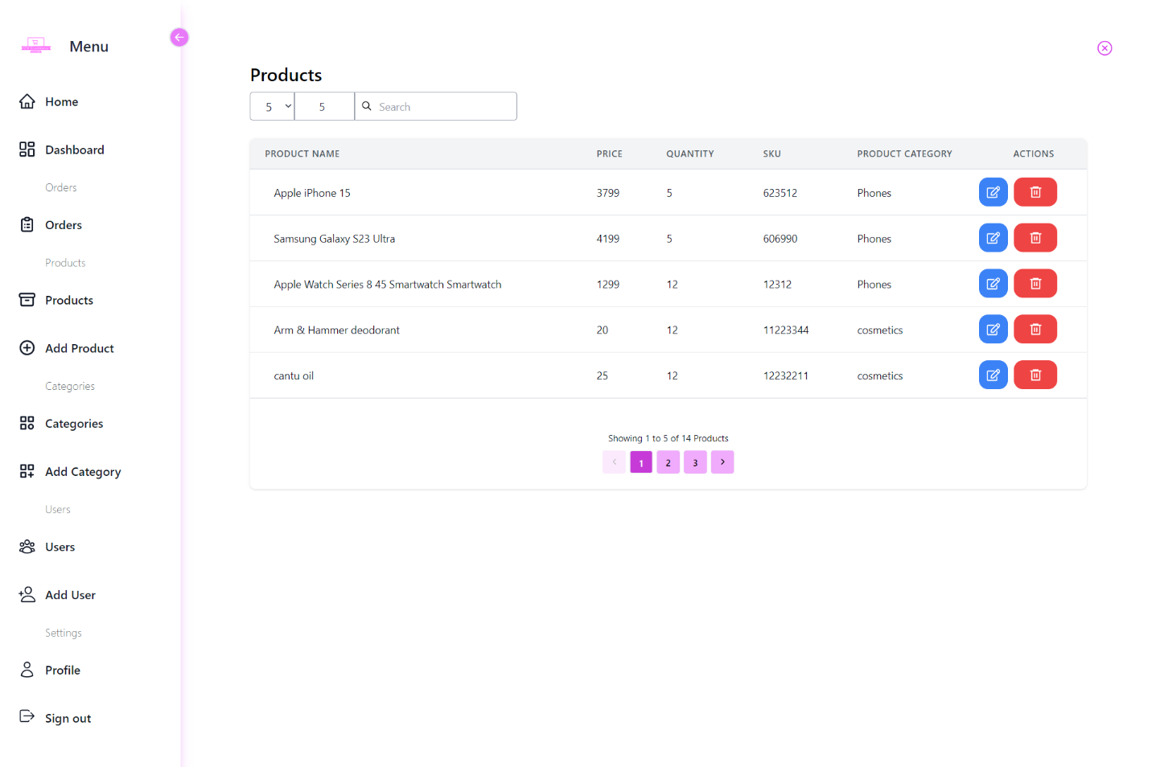
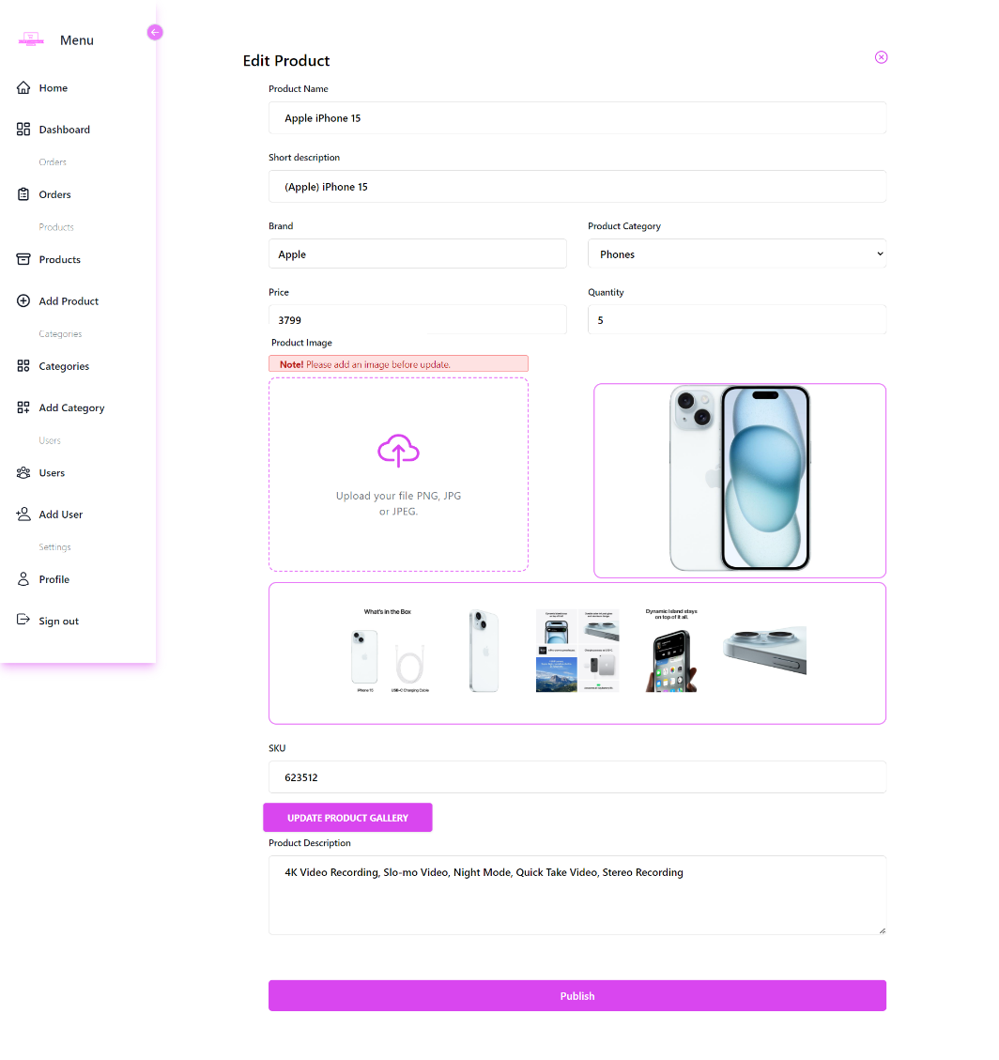
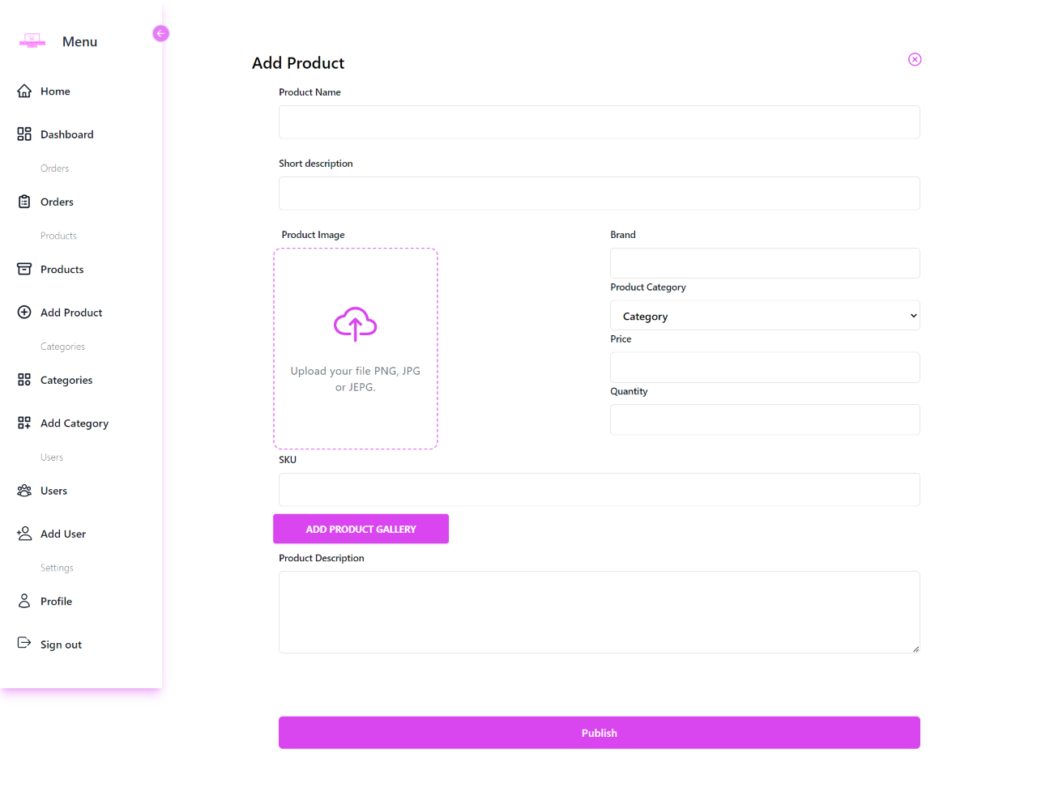
Products pages
29

Slide 44
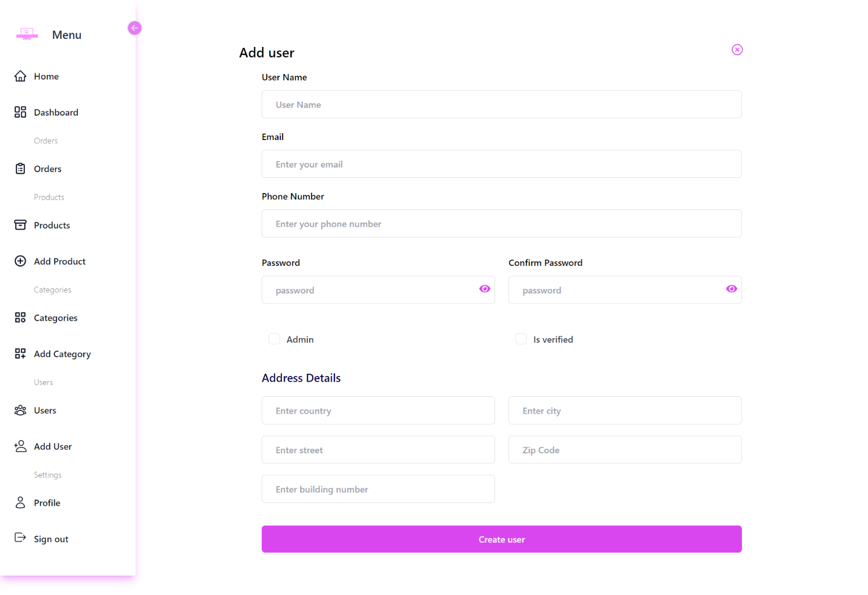
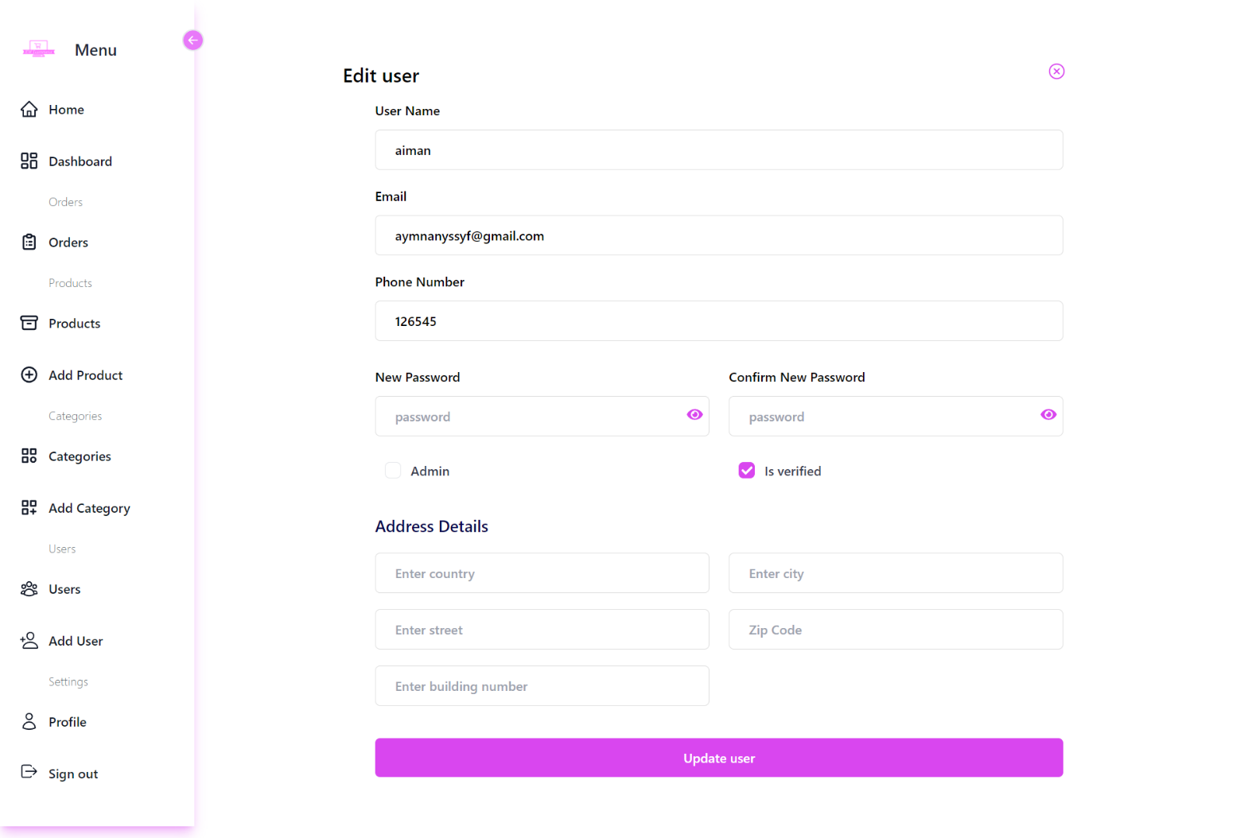
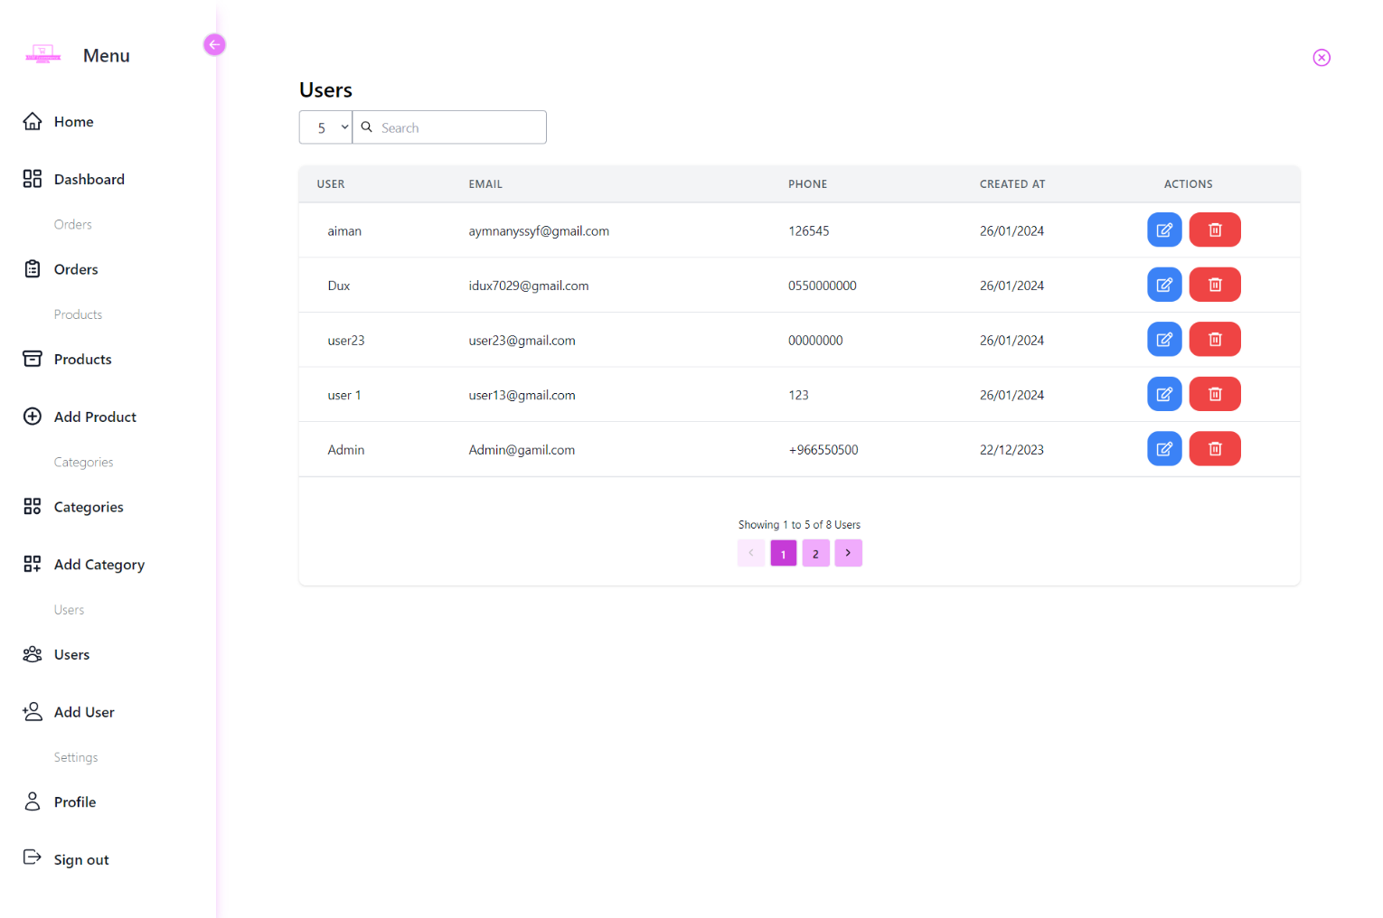
Users pages
30

Slide 45
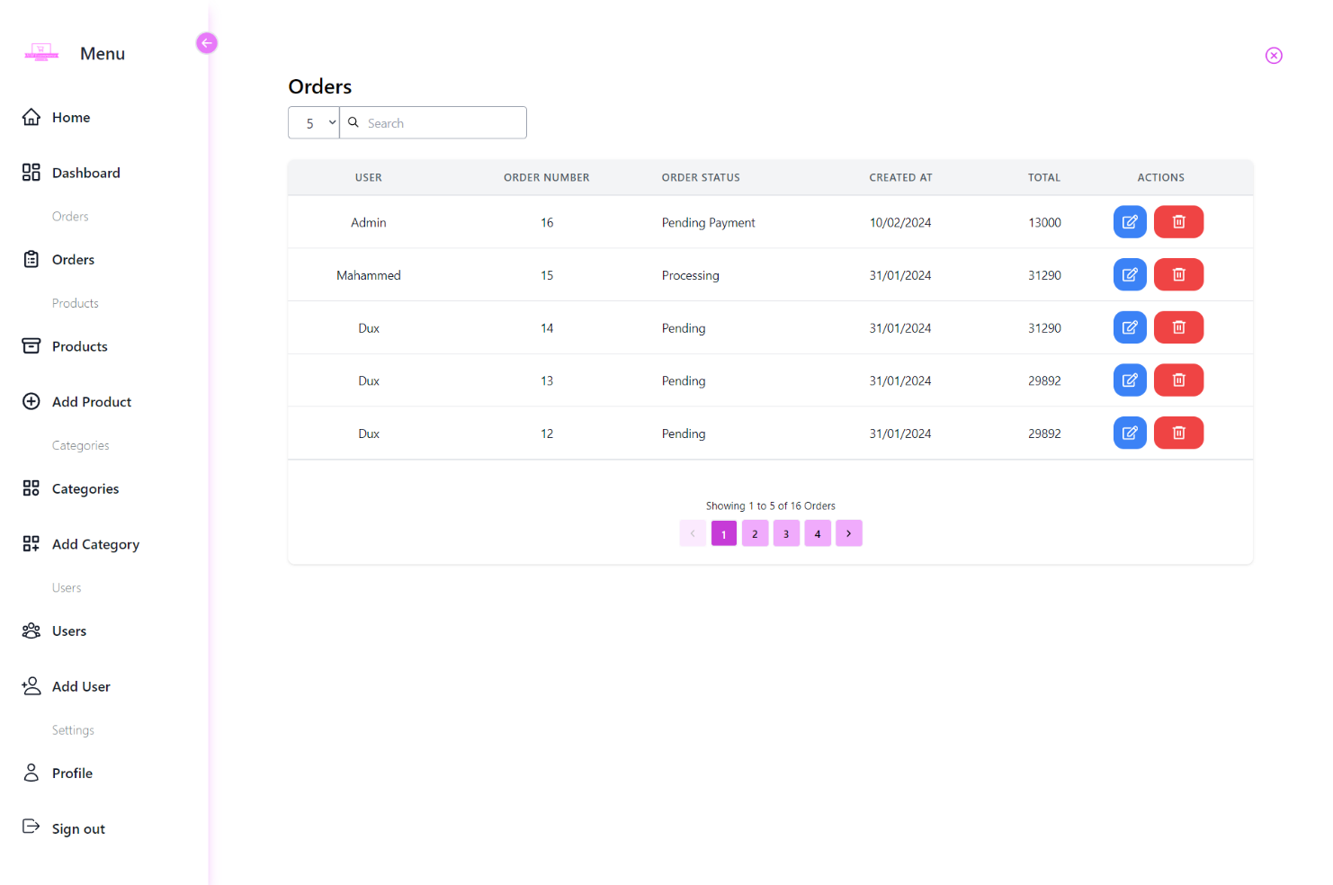
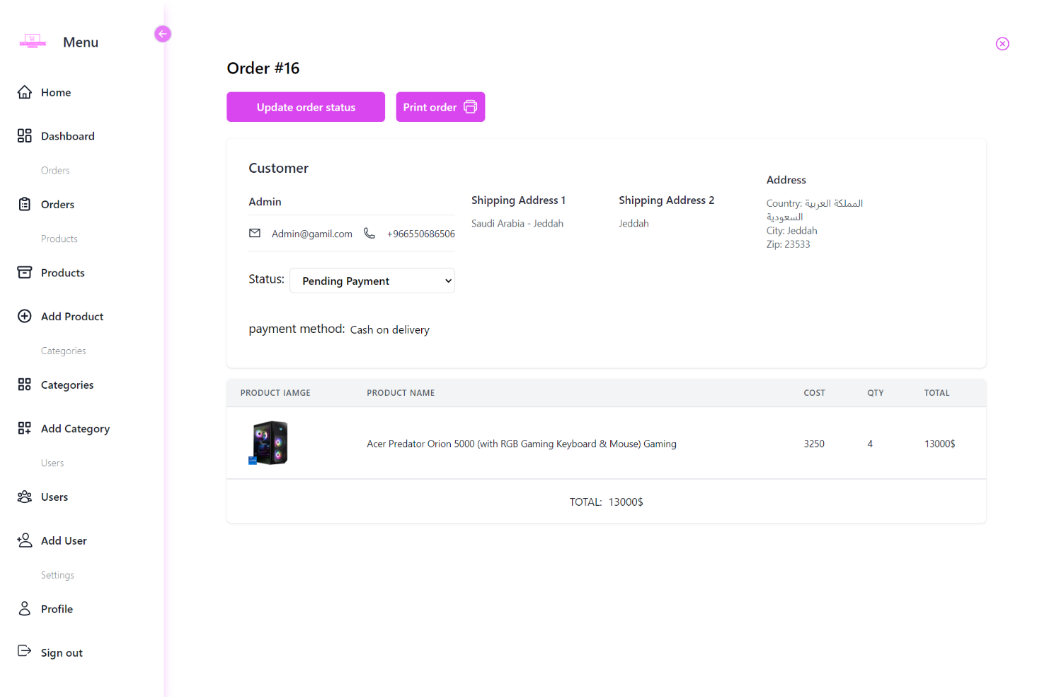
Orders pages
31

Slide 46

Future Scope
The e-commerce landscape is rapidly evolving, and IEM E-commerce must keep pace by embracing the latest trends and technologies.
Objectives
Boost sales
Enhance performance
Expand customer base:
Reach new countries and languages.
Offer a wider range of products and services to meet customer needs.
Enhance user experience for improved usability.
Strengthen marketing efforts to raise awareness.
Implement attractive promotions and offers.
Optimize the purchase journey for ease and speed.
Improve website speed and responsiveness.
Strengthen website security and data protection.
Leverage analytics to gain deeper customer insights.
32

Slide 47
Initiatives
Introduce new features
Focus on Search Engine Optimization (SEO):
Develop mobile apps:
Create iOS and Android apps for seamless access.
Enable mobile payments for convenience.
Implement push notifications for engagement.
Integrate a product review system for valuable feedback.
Implement product recommendation algorithms for personalization.
Offer live chat support for real-time assistance.
Optimize website content for relevant keywords.
Build high-quality backlinks to improve ranking.
Enhance website loading speed for performance.
33

Slide 48
Invest in digital marketing
Refine website analytics
Run targeted ad campaigns on platforms like Facebook and Instagram.
Implement email marketing initiatives for outreach.
Collaborate with relevant social media influencers.
Utilize data analytics tools for deeper customer understanding.
Continuously improve user experience based on insights.
By focusing on these initiatives, IEM E-commerce can expand its reach, increase sales, and enhance its overall performance.
34

Slide 49
Conclusion
As I bring this presentation on "IEM ECOMMERCE" to a close, I am filled with a sense of accomplishment and gratitude for the journey that I have embarked on during my academic pursuit. While "IEM ECOMMERCE" may be a project for my graduation, the lessons learned and skills honed throughout its development have been invaluable.
Growth and Learning:
Through the development of "IEM ECOMMERCE," I have grown both personally and professionally. From mastering new technologies to refining my problem-solving skills, every step of the journey has been a learning opportunity.
Challenges and Solutions:
The journey was not without its challenges, but each obstacle presented an opportunity to innovate and find creative solutions. Overcoming these challenges has instilled in me a sense of resilience and determination.
Teamwork and Collaboration:
While this project may have been completed individually, I am grateful for the support and guidance of my professors, mentors, and peers who have been a source of inspiration and encouragement throughout the process.
35

Slide 50
Conclusion
Looking Ahead:
As I conclude this chapter of my academic journey, I am excited about the possibilities that lie ahead. Whether it be further education or entering the workforce, I am confident that the skills and experiences gained from "IEM ECOMMERCE" will serve me well in my future endeavors.
Acknowledgments:
I would like to extend my heartfelt gratitude to everyone who has supported me along the way. From my professors who provided guidance and feedback to my friends and family who offered unwavering encouragement, I am truly thankful for your support.
In closing, "IEM ECOMMERCE" may be a project for my graduation, but the lessons learned and experiences gained will last a lifetime. Thank you for being a part of this journey.
36

Slide 51
Thank you for your attention and participation throughout the presentation.

